Slide 1
Portfolio Milestone
Randy Geszvain

Slide 2
Intro
Randy Geszvain
Applied Data Science Graduate
  Business Concepts
  Programming
  Data Analytics
  Ethics
Background

Slide 3
Outline
Overview of the learning journey (project breakdown)
Collect and organize data
Data programming and analytics
Alternative strategies
Plan of implementations
Demonstrate communication skills regarding data and its analysis for the stakeholders
Synthesize the ethical dimensions of data science practice

Slide 4
Overview of the learning journey

Slide 5
Project 1 -
Overview
Walkthrough

Slide 6
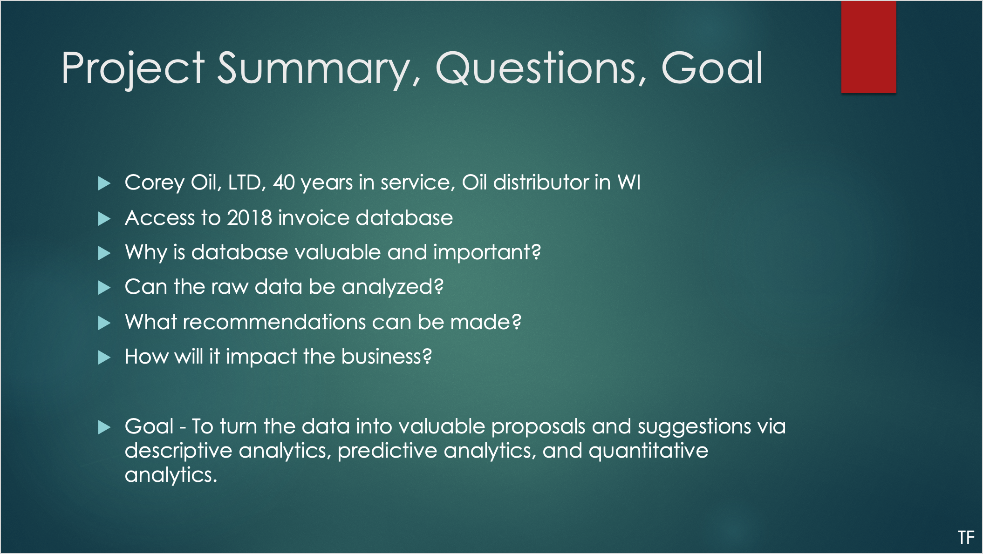

Slide 7
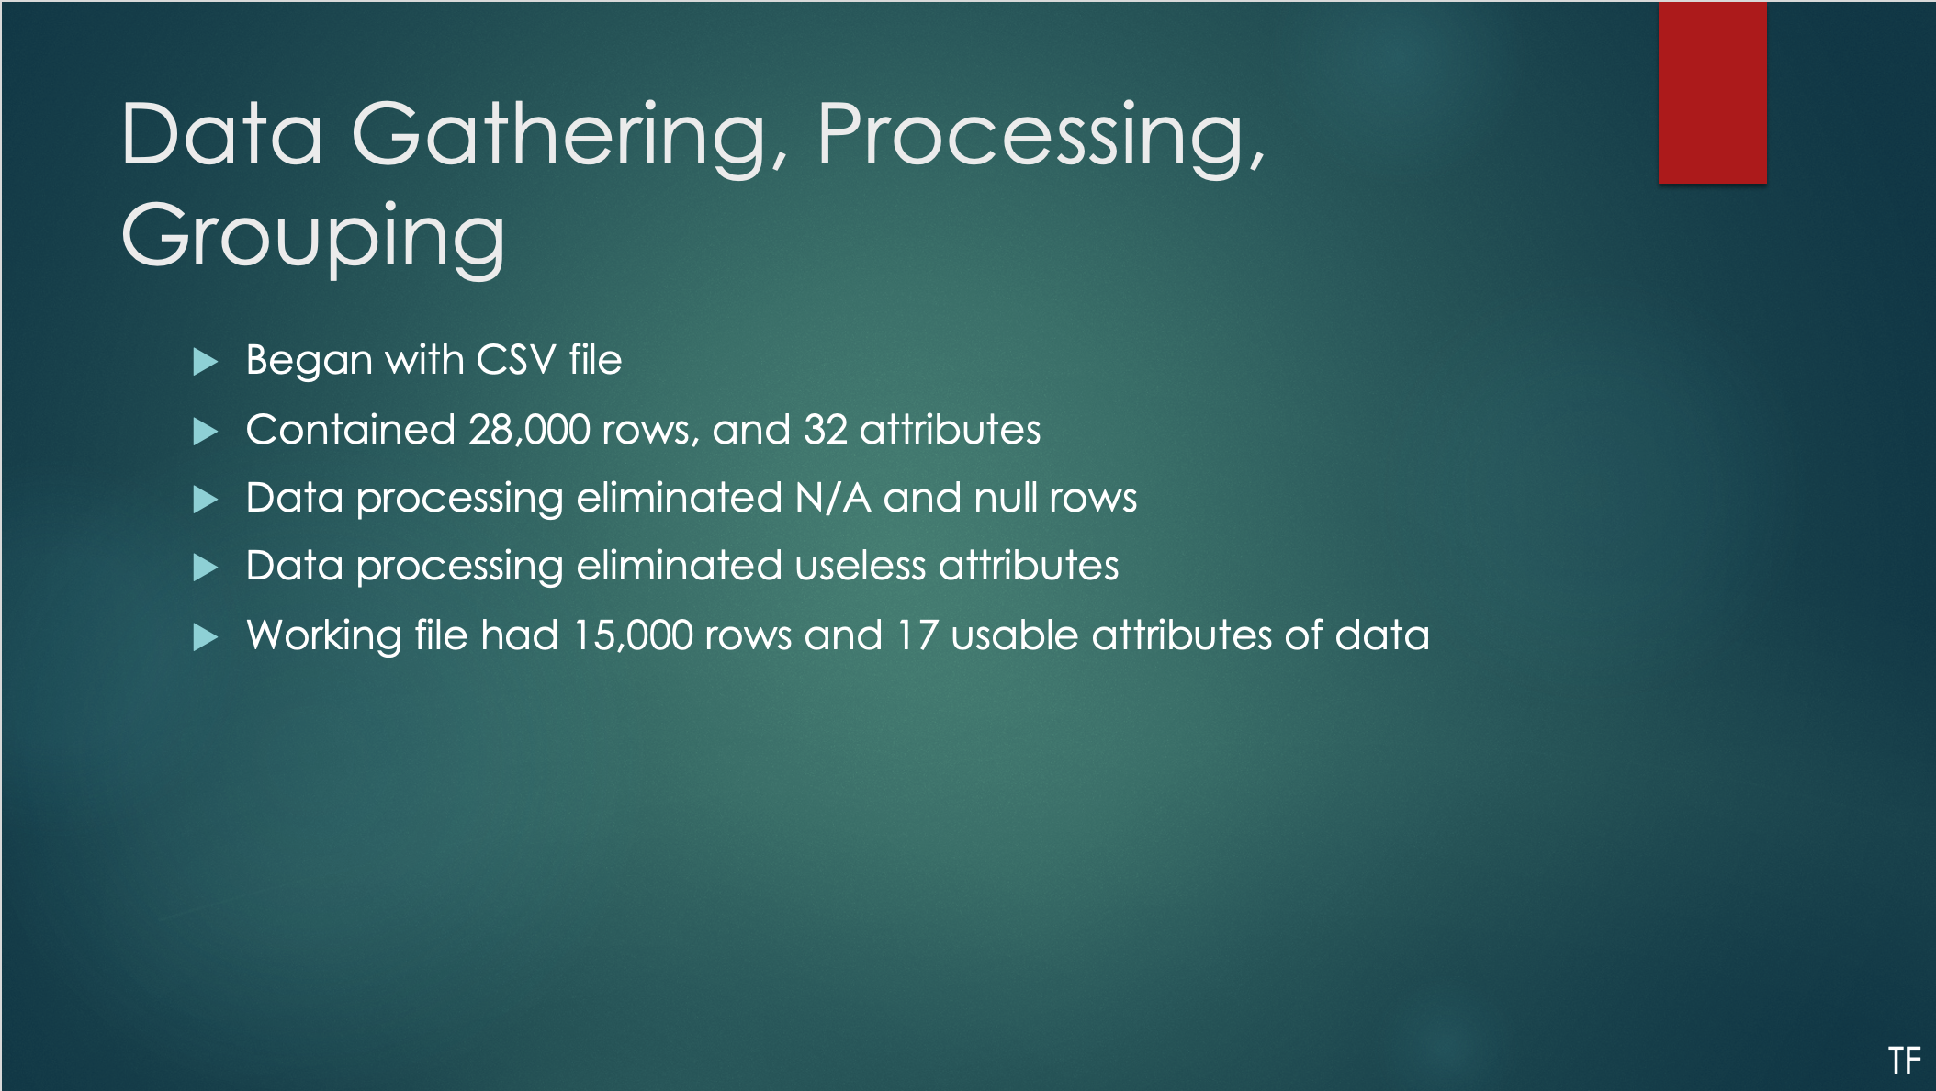

Slide 8
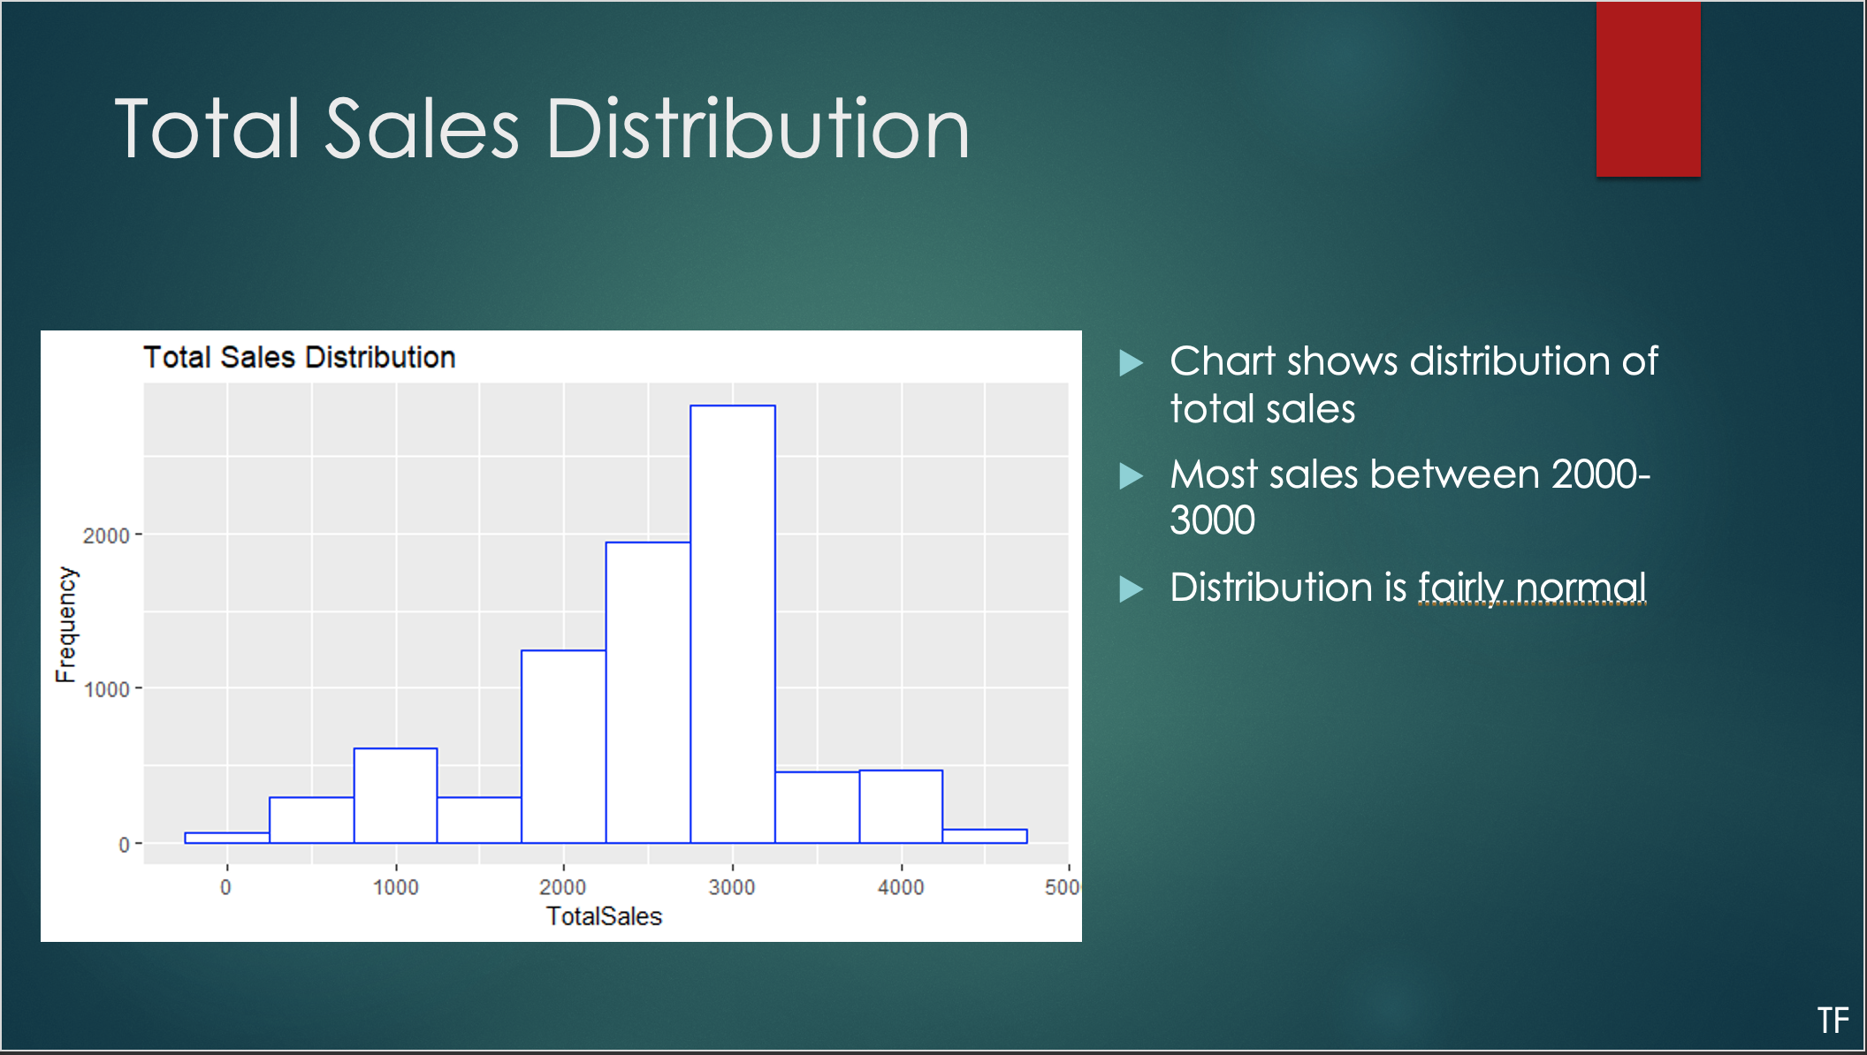

Slide 9
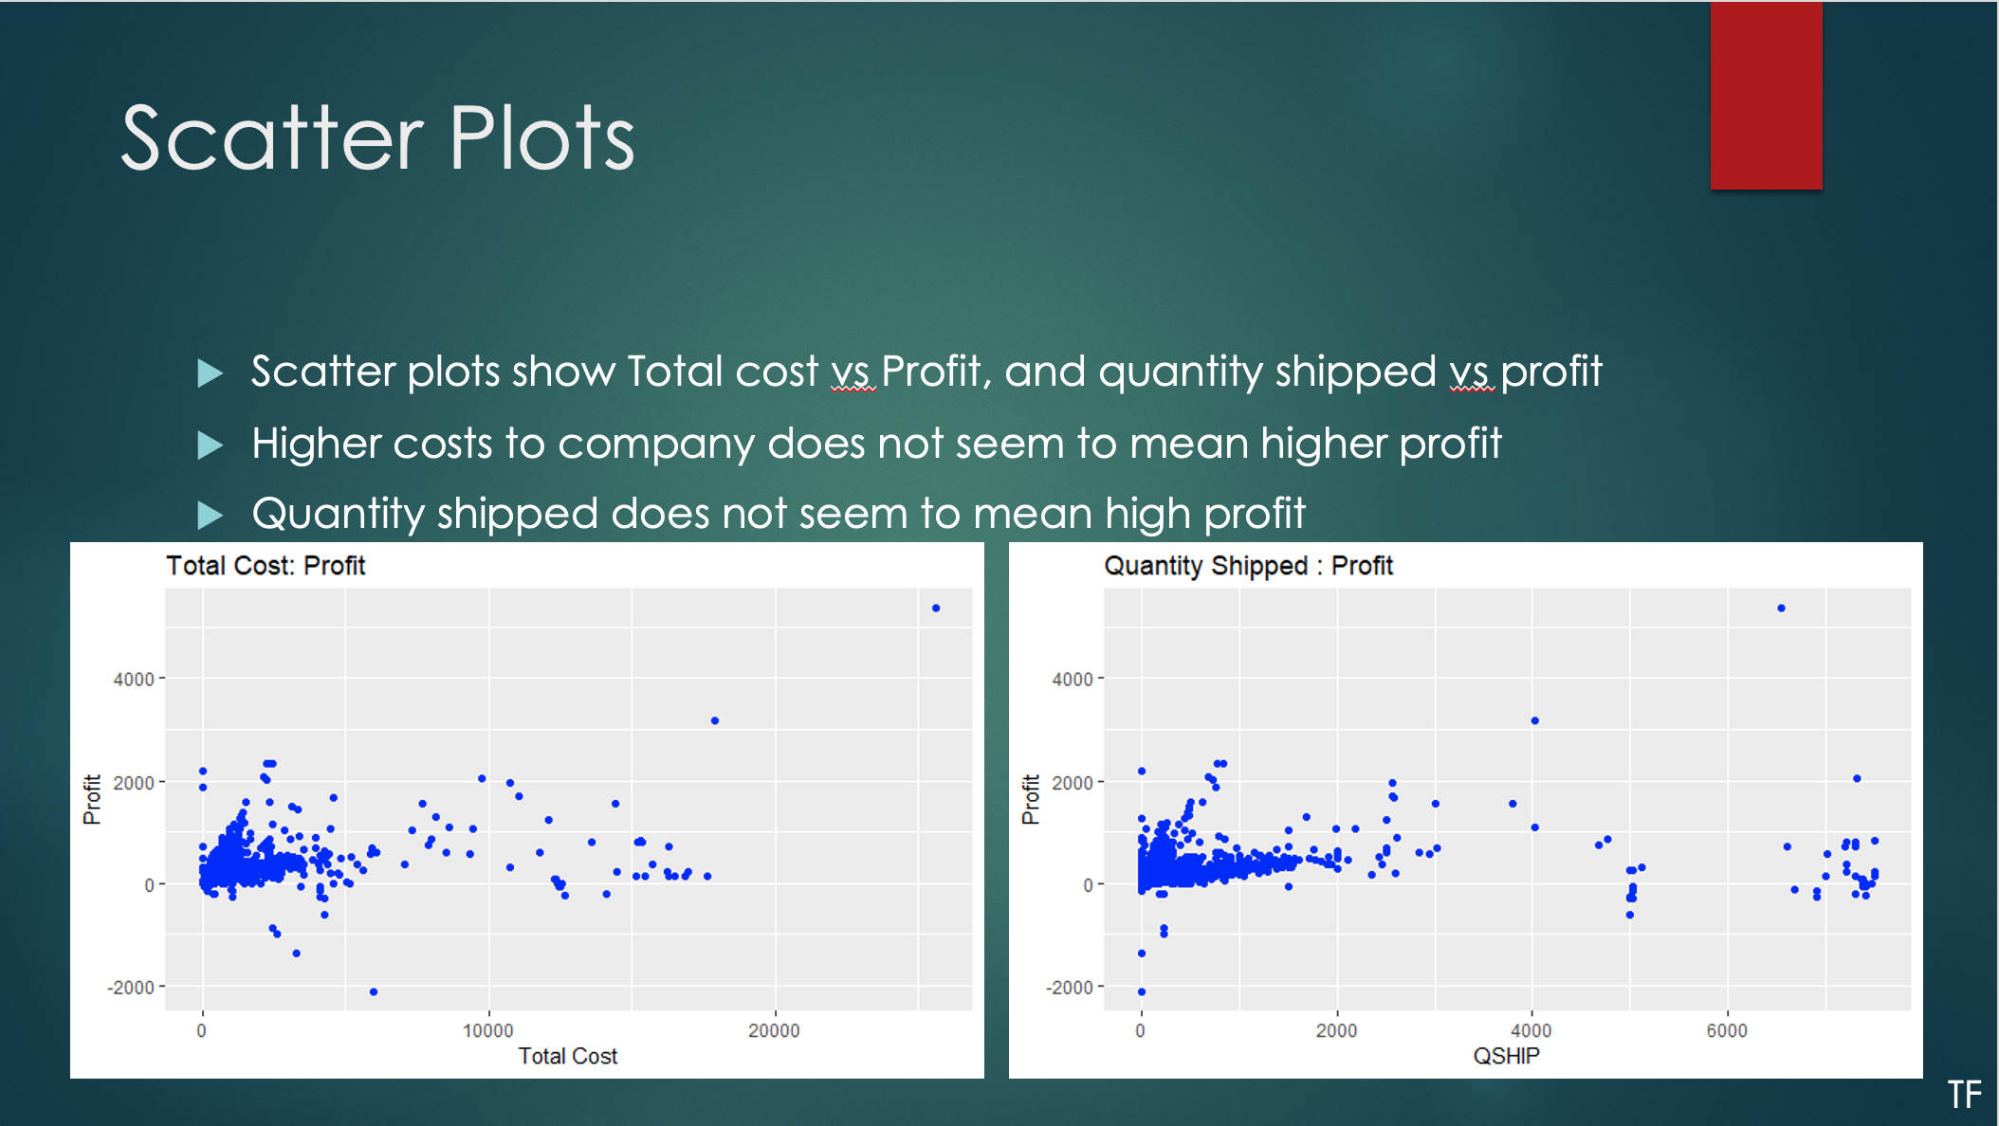

Slide 11
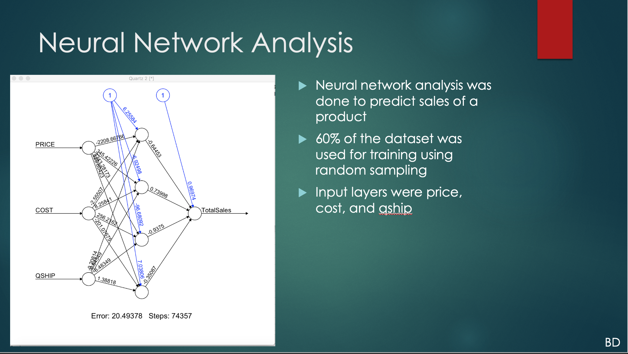

Slide 12
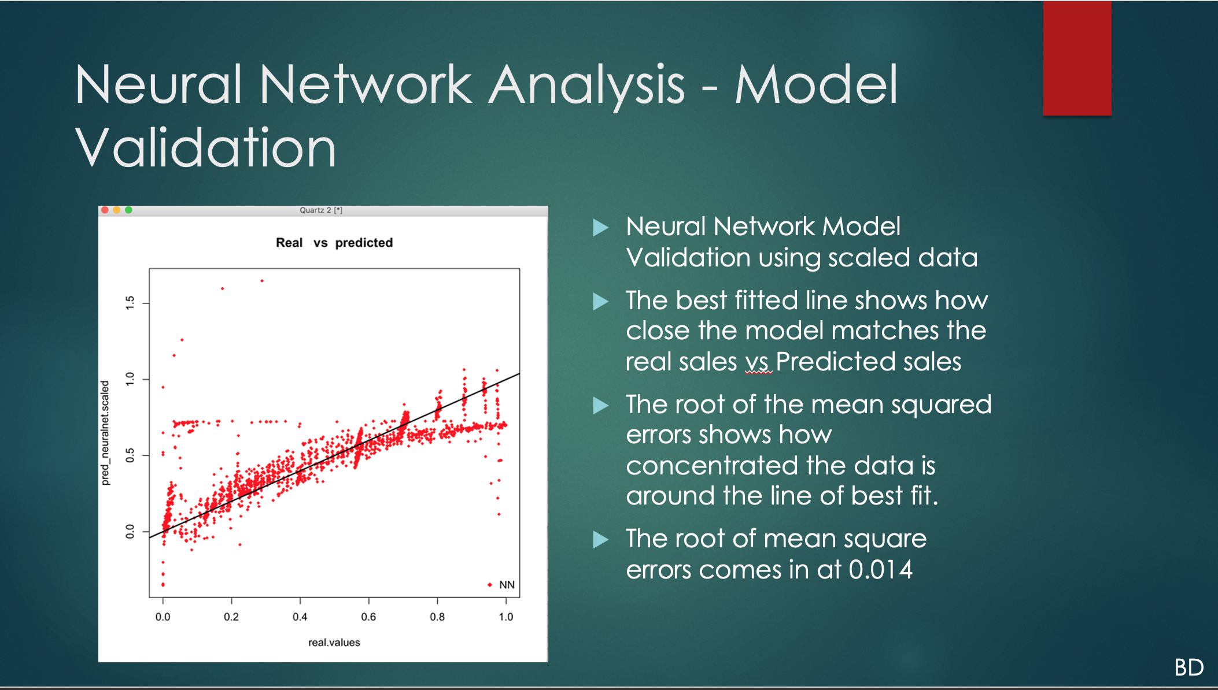

Slide 13
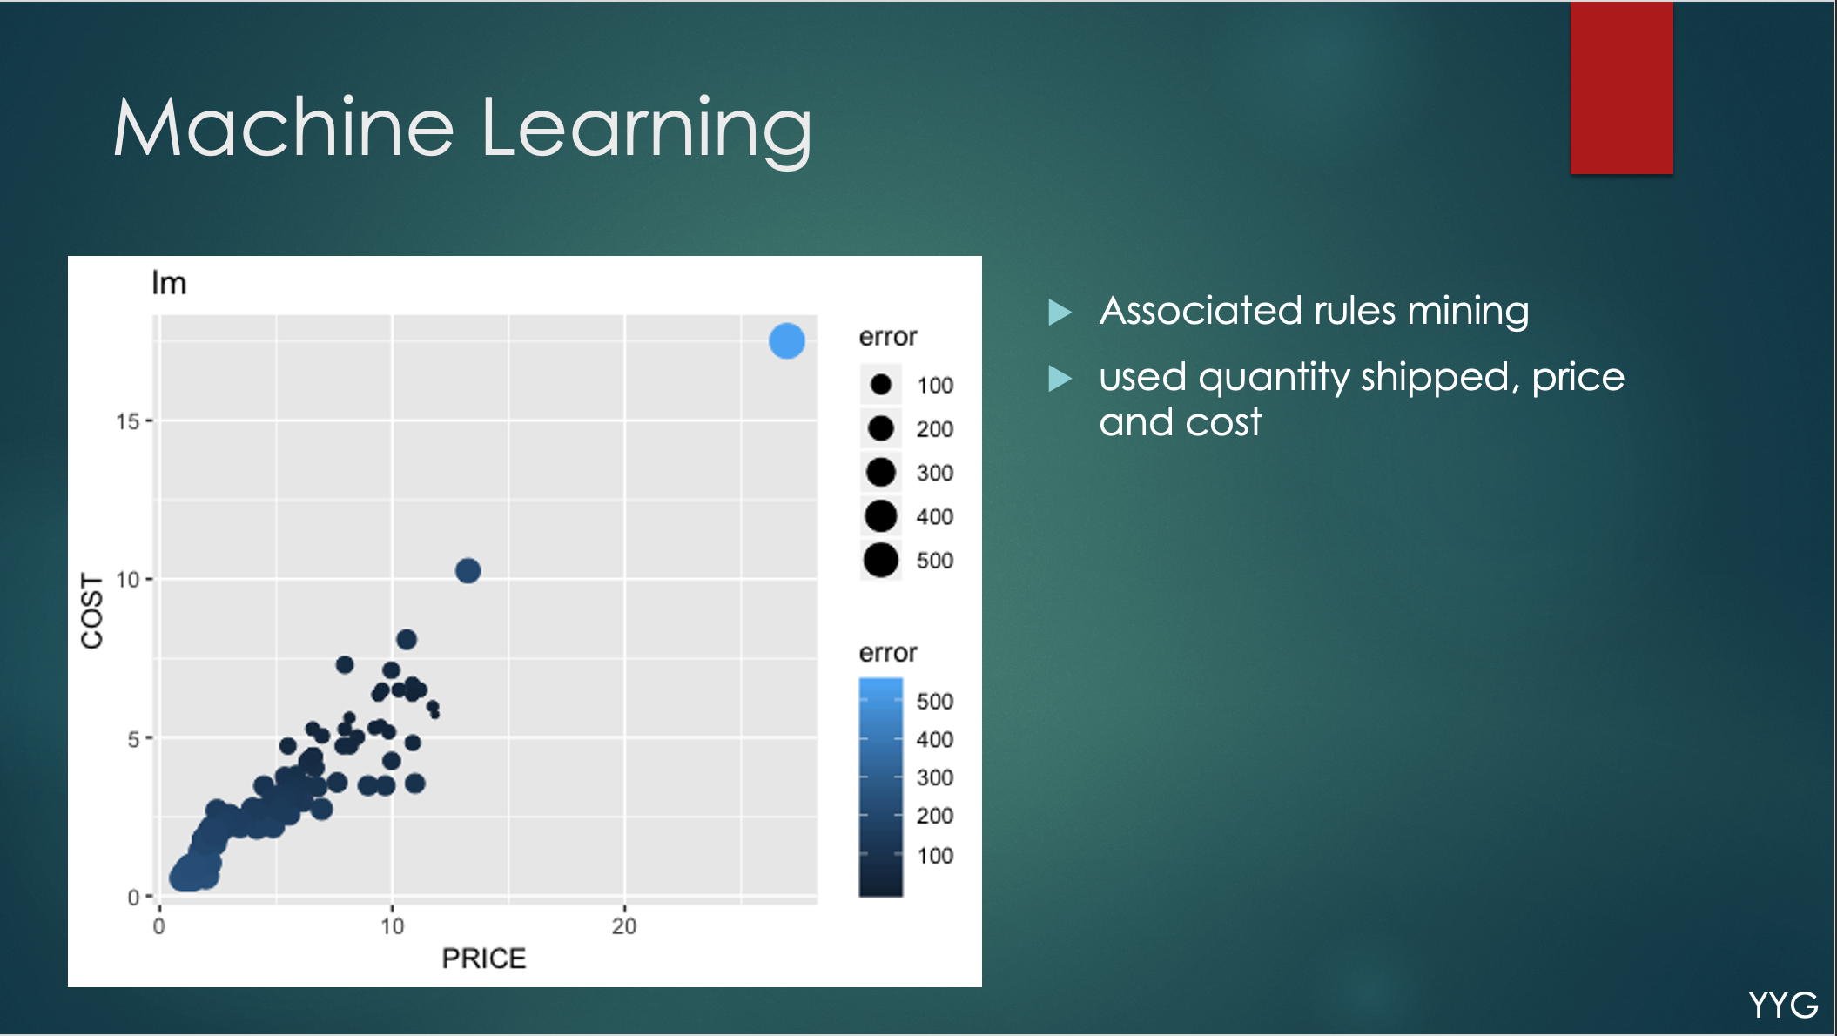

Slide 14
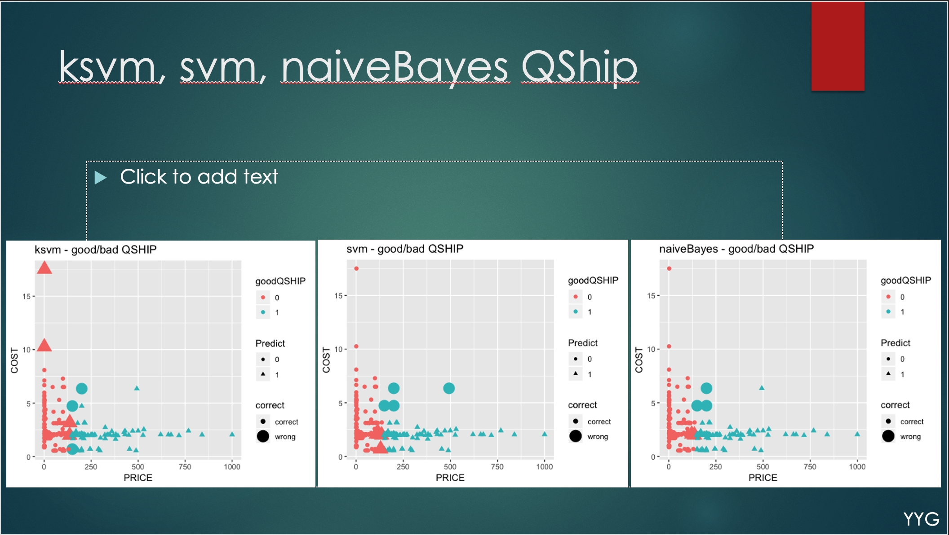

Slide 15
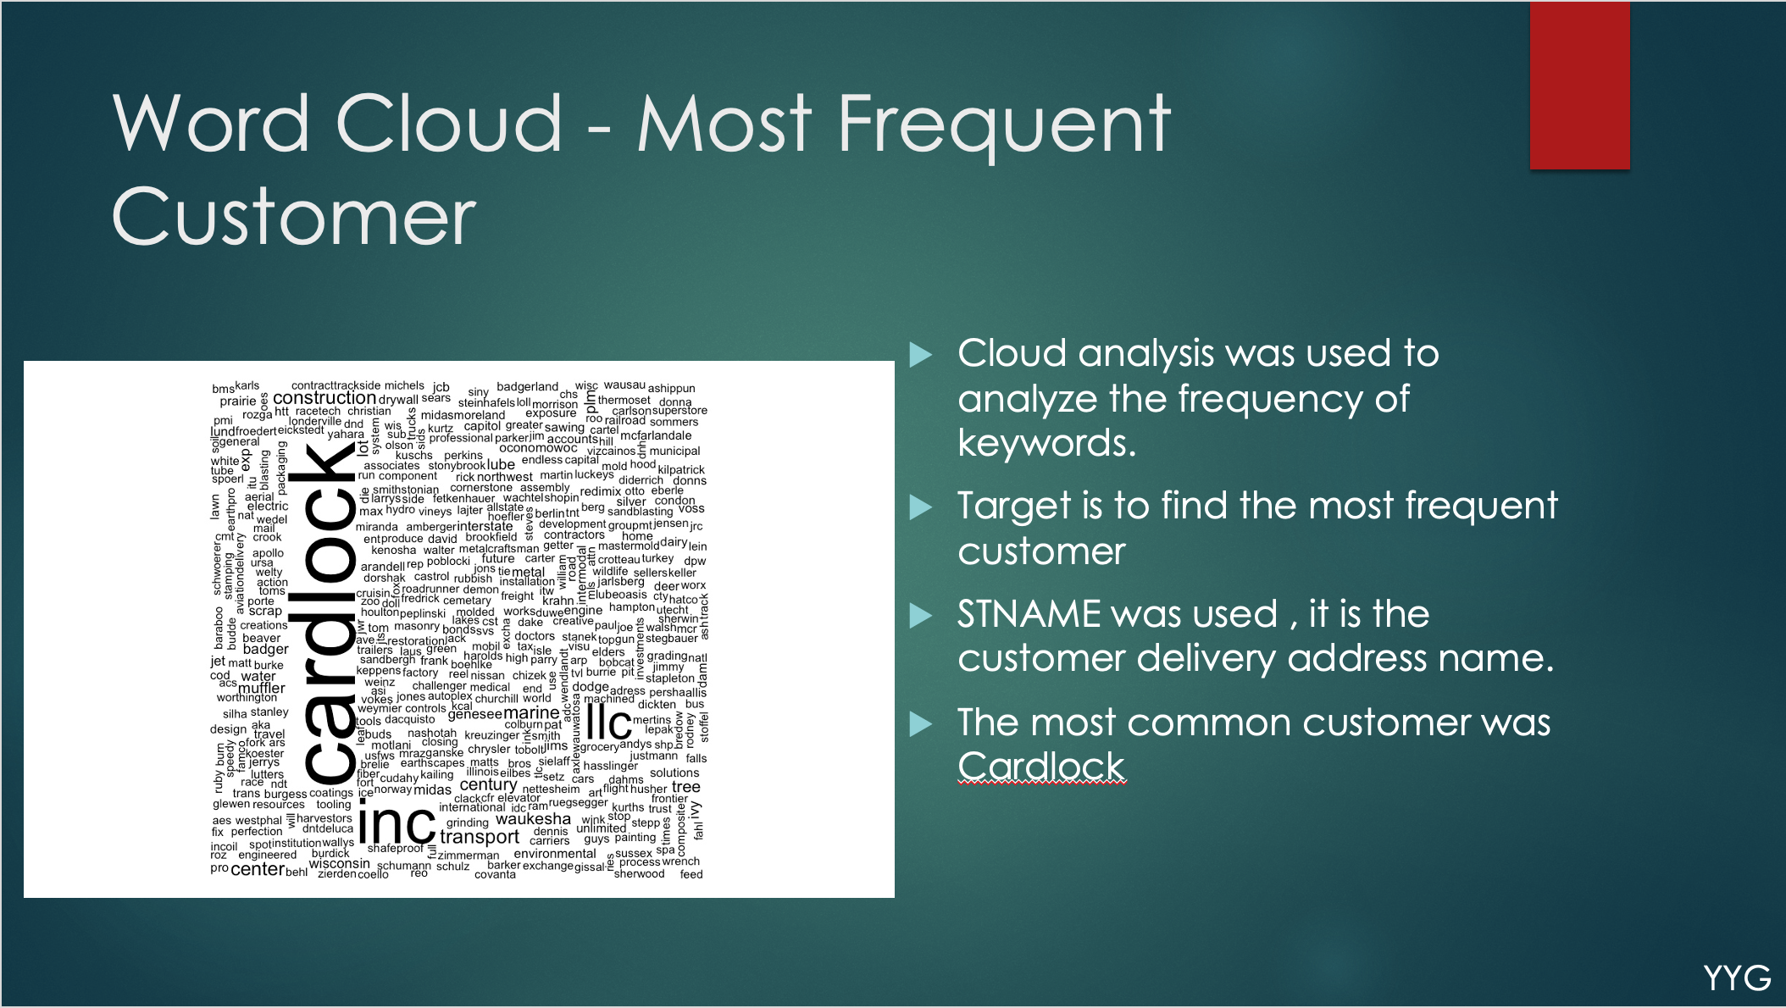

Slide 16
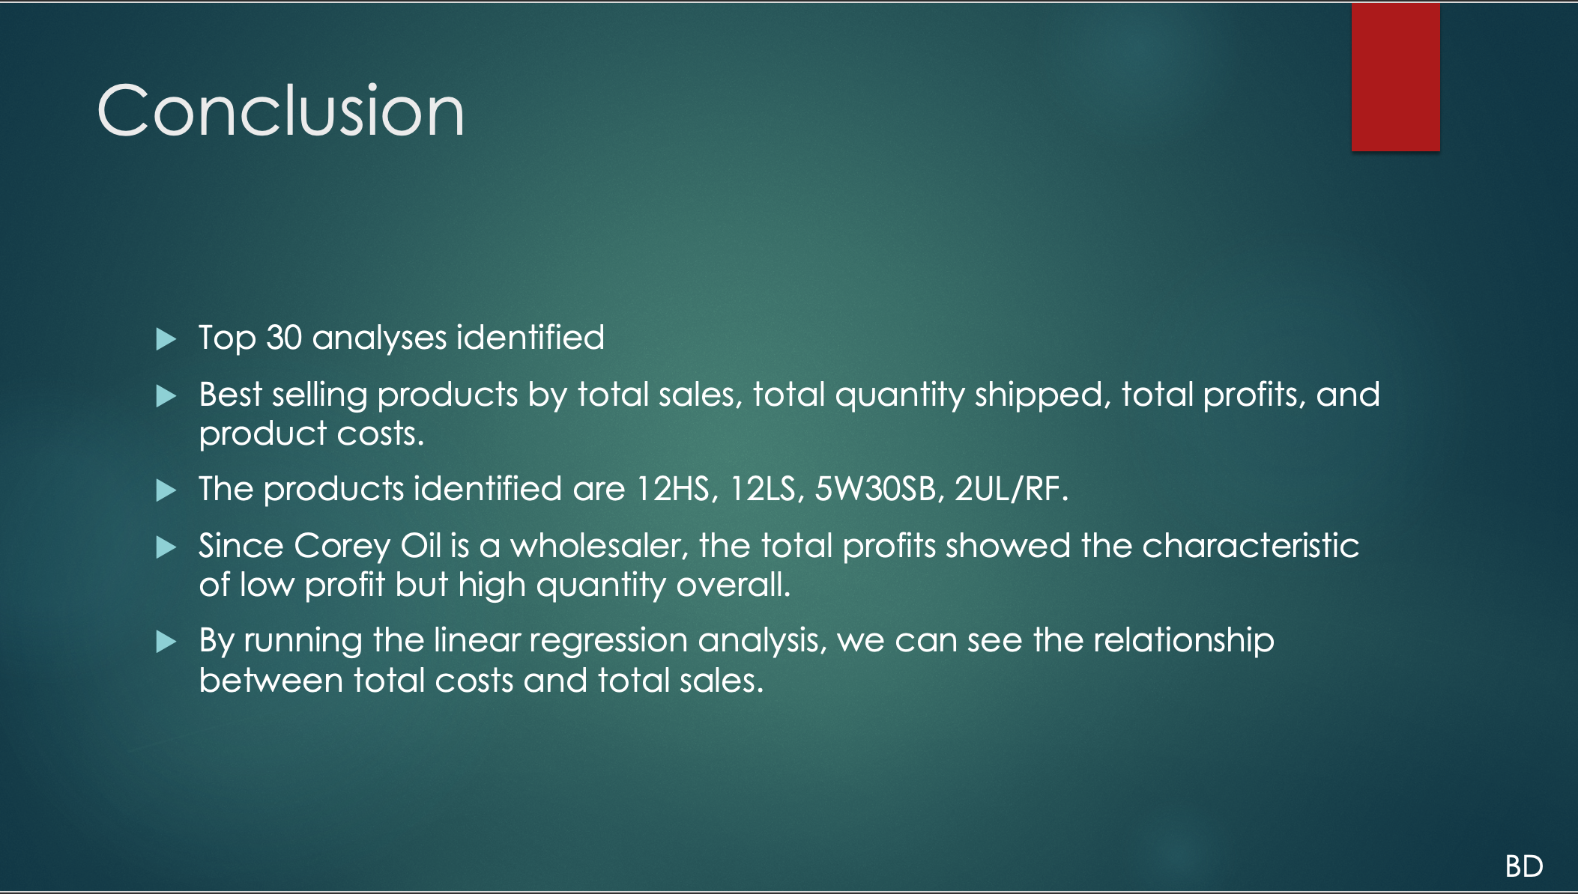

Slide 17
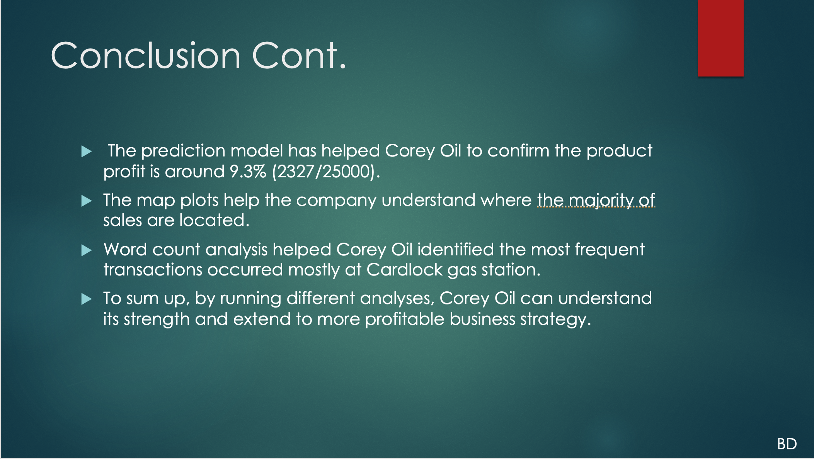

Slide 18
Project 2 -
Overview
Walkthrough

Slide 19
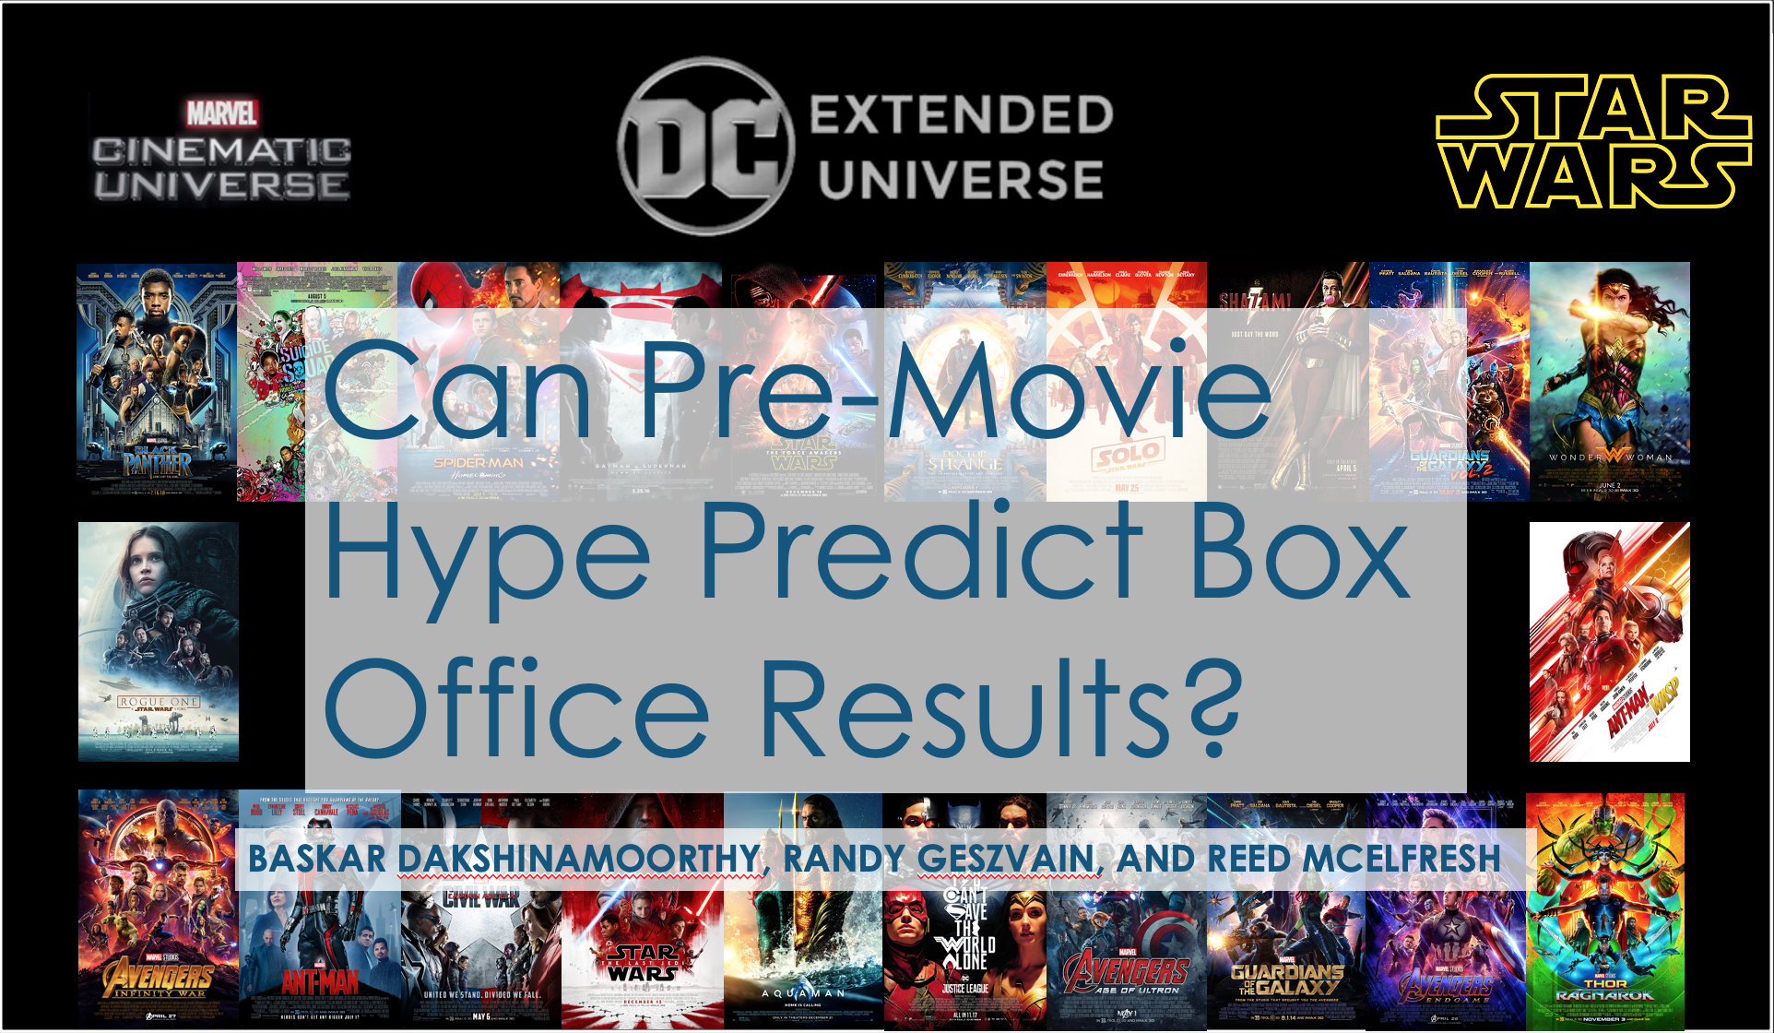

Slide 20
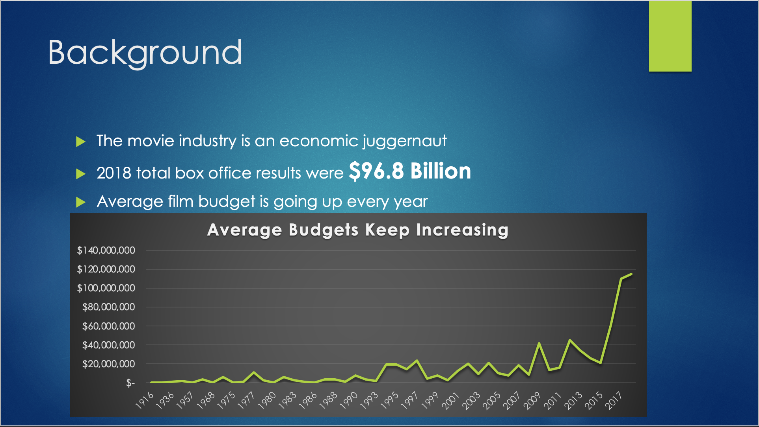

Slide 21
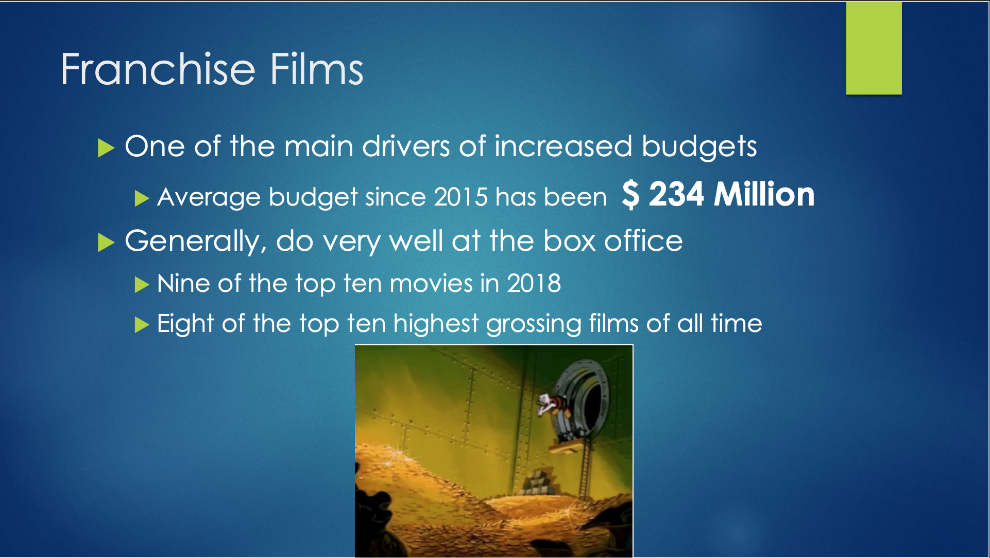

Slide 23
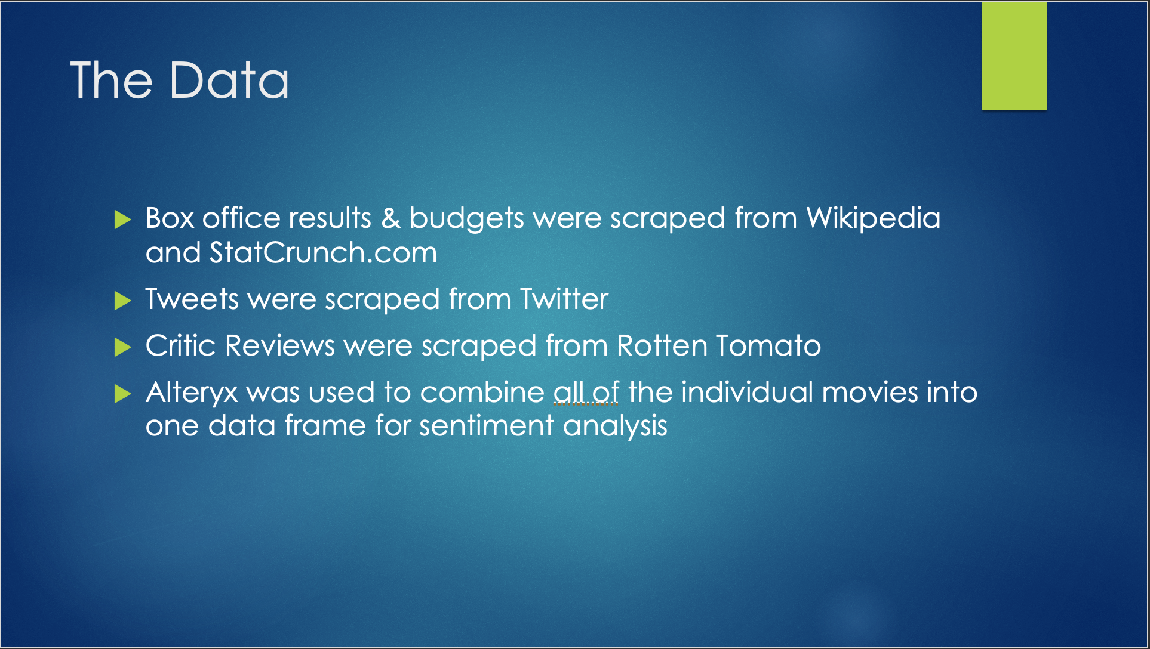

Slide 24
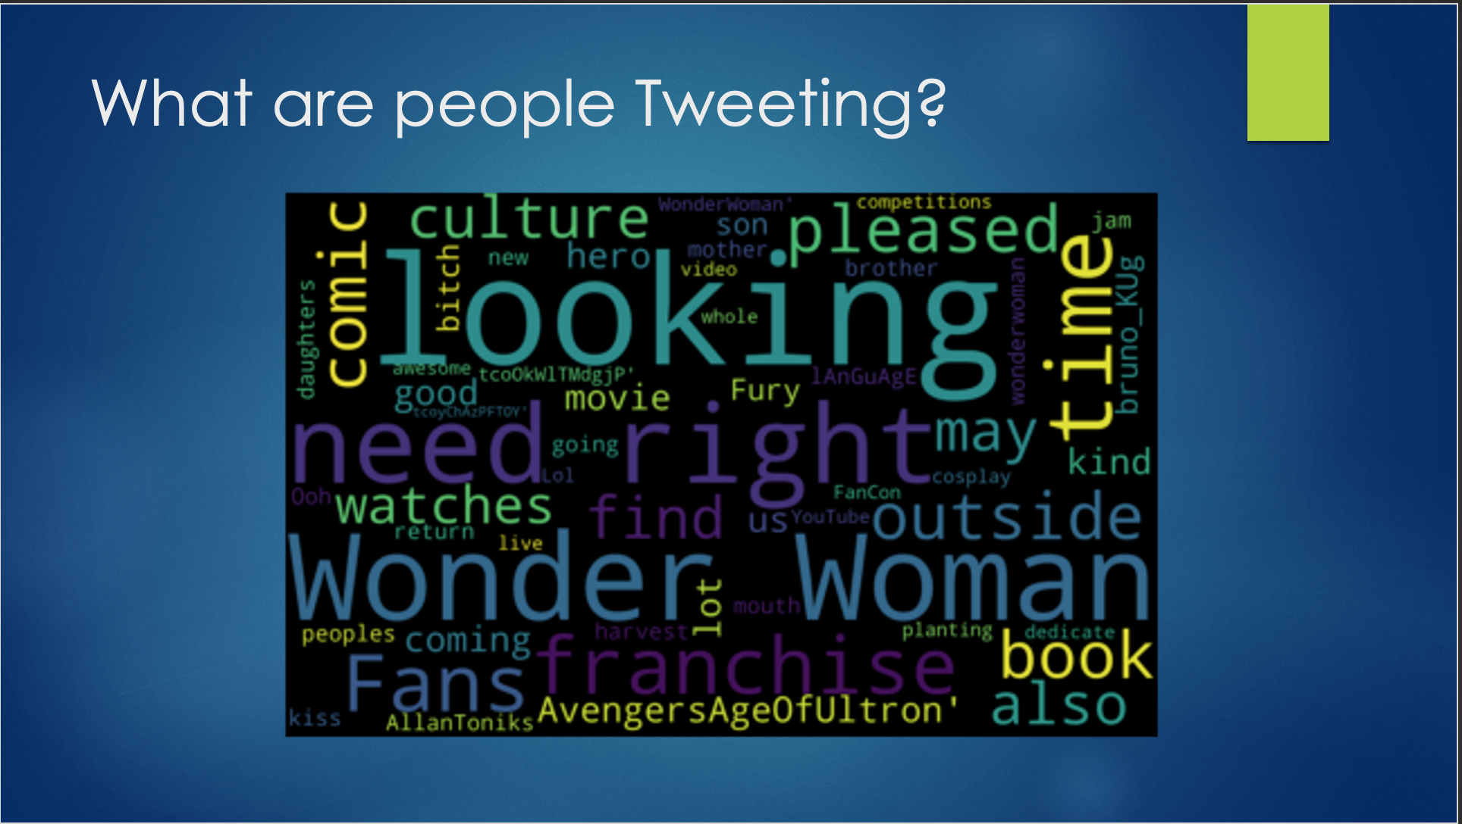

Slide 25
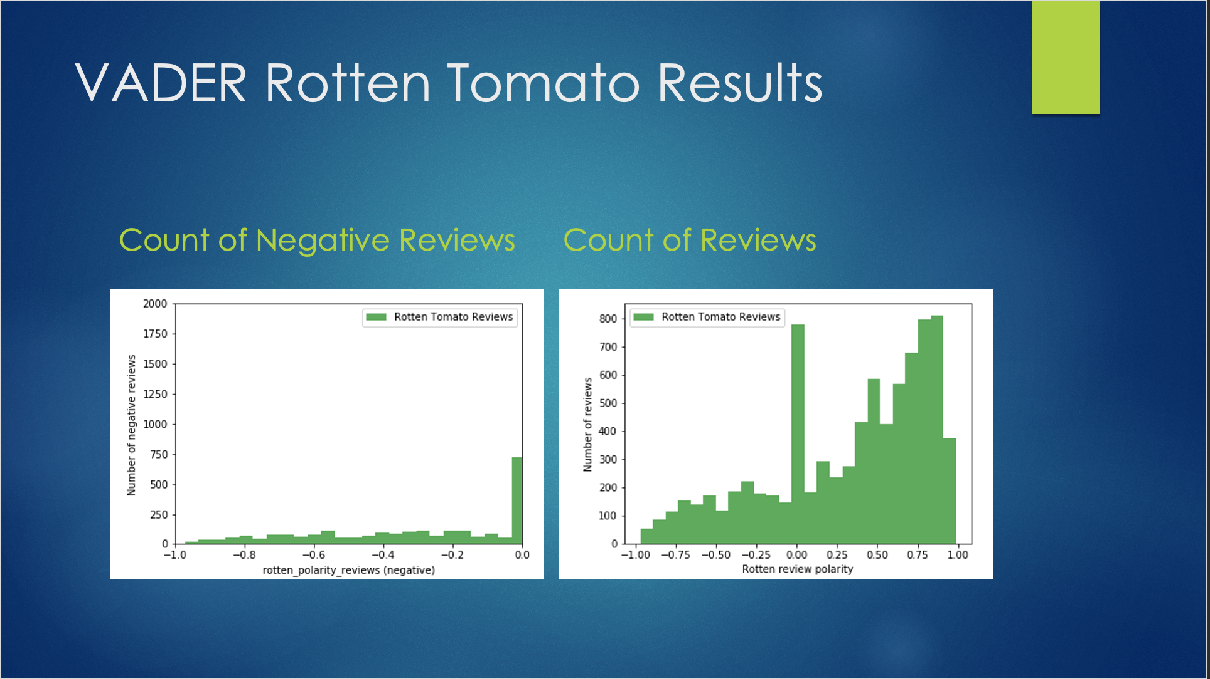

Slide 26
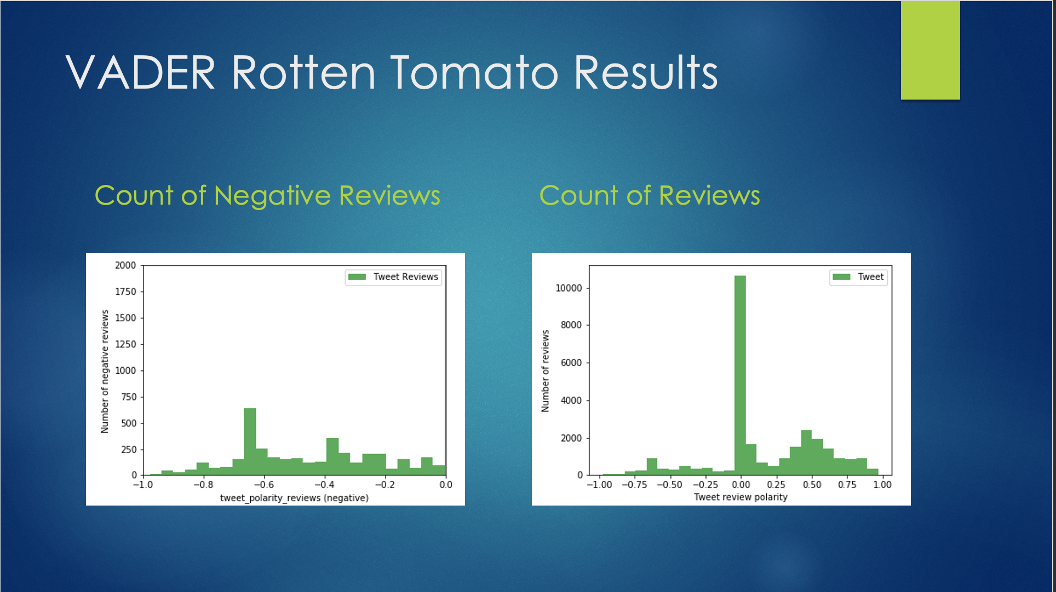

Slide 27
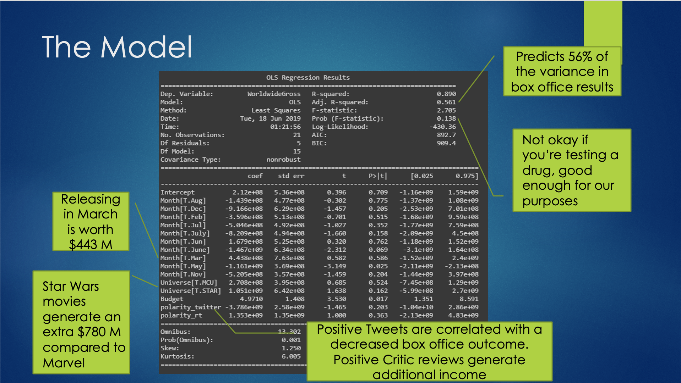

Slide 28
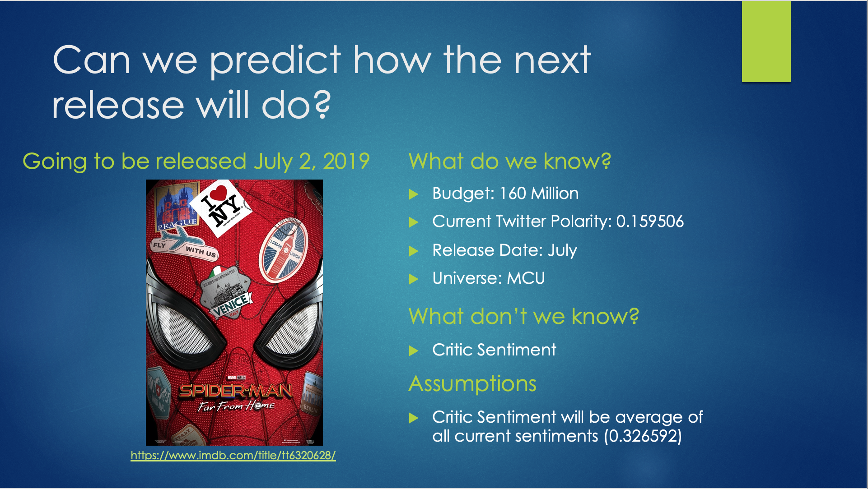

Slide 29
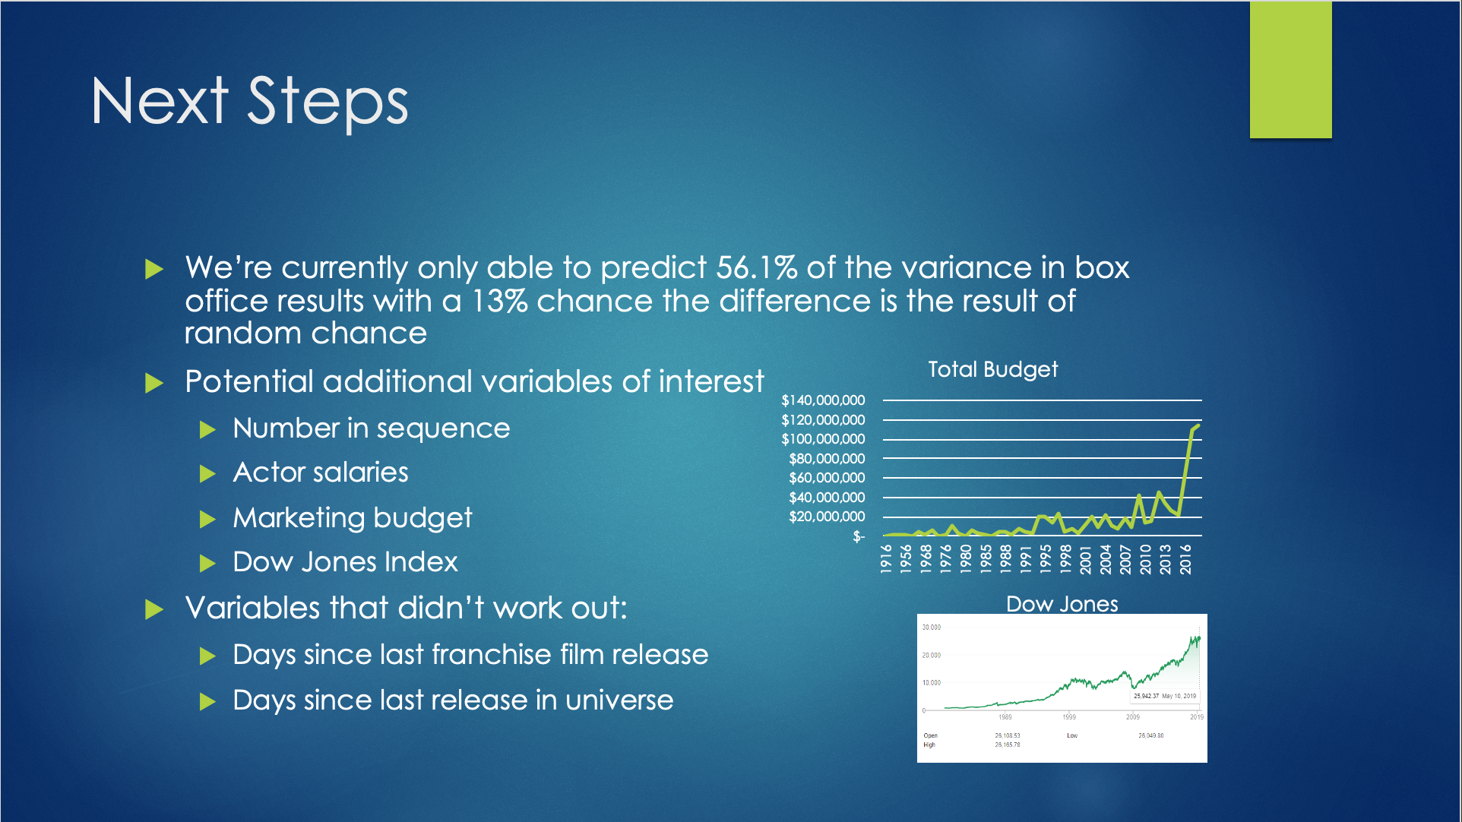

Slide 30
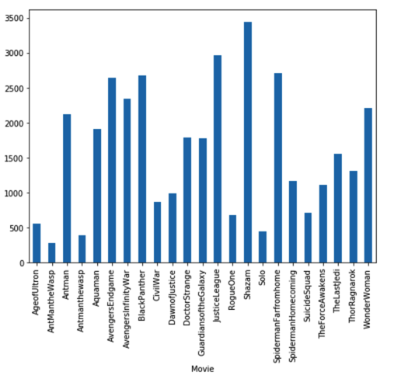
Multi-Class Text Classification with Scikit-Learn

Slide 31
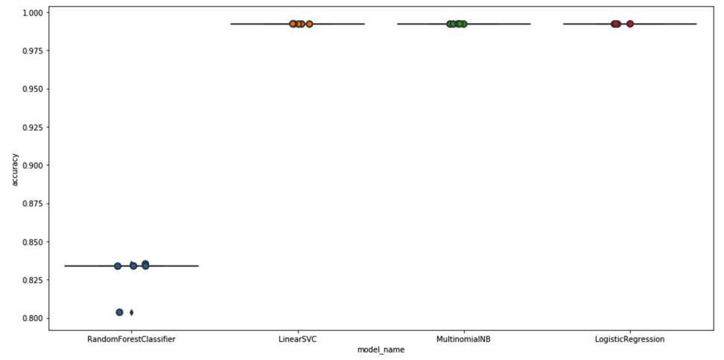
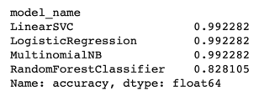
the prediction accuracies from each prediction method. We got the same accuracy score (0.992282) for Linear SVC, Logistic Regression, and Multinomial NB. Random Forest Classifier has a lower accuracy score (0.828105.)

Slide 32
Project 3 -
Overview
Walkthrough

Slide 33
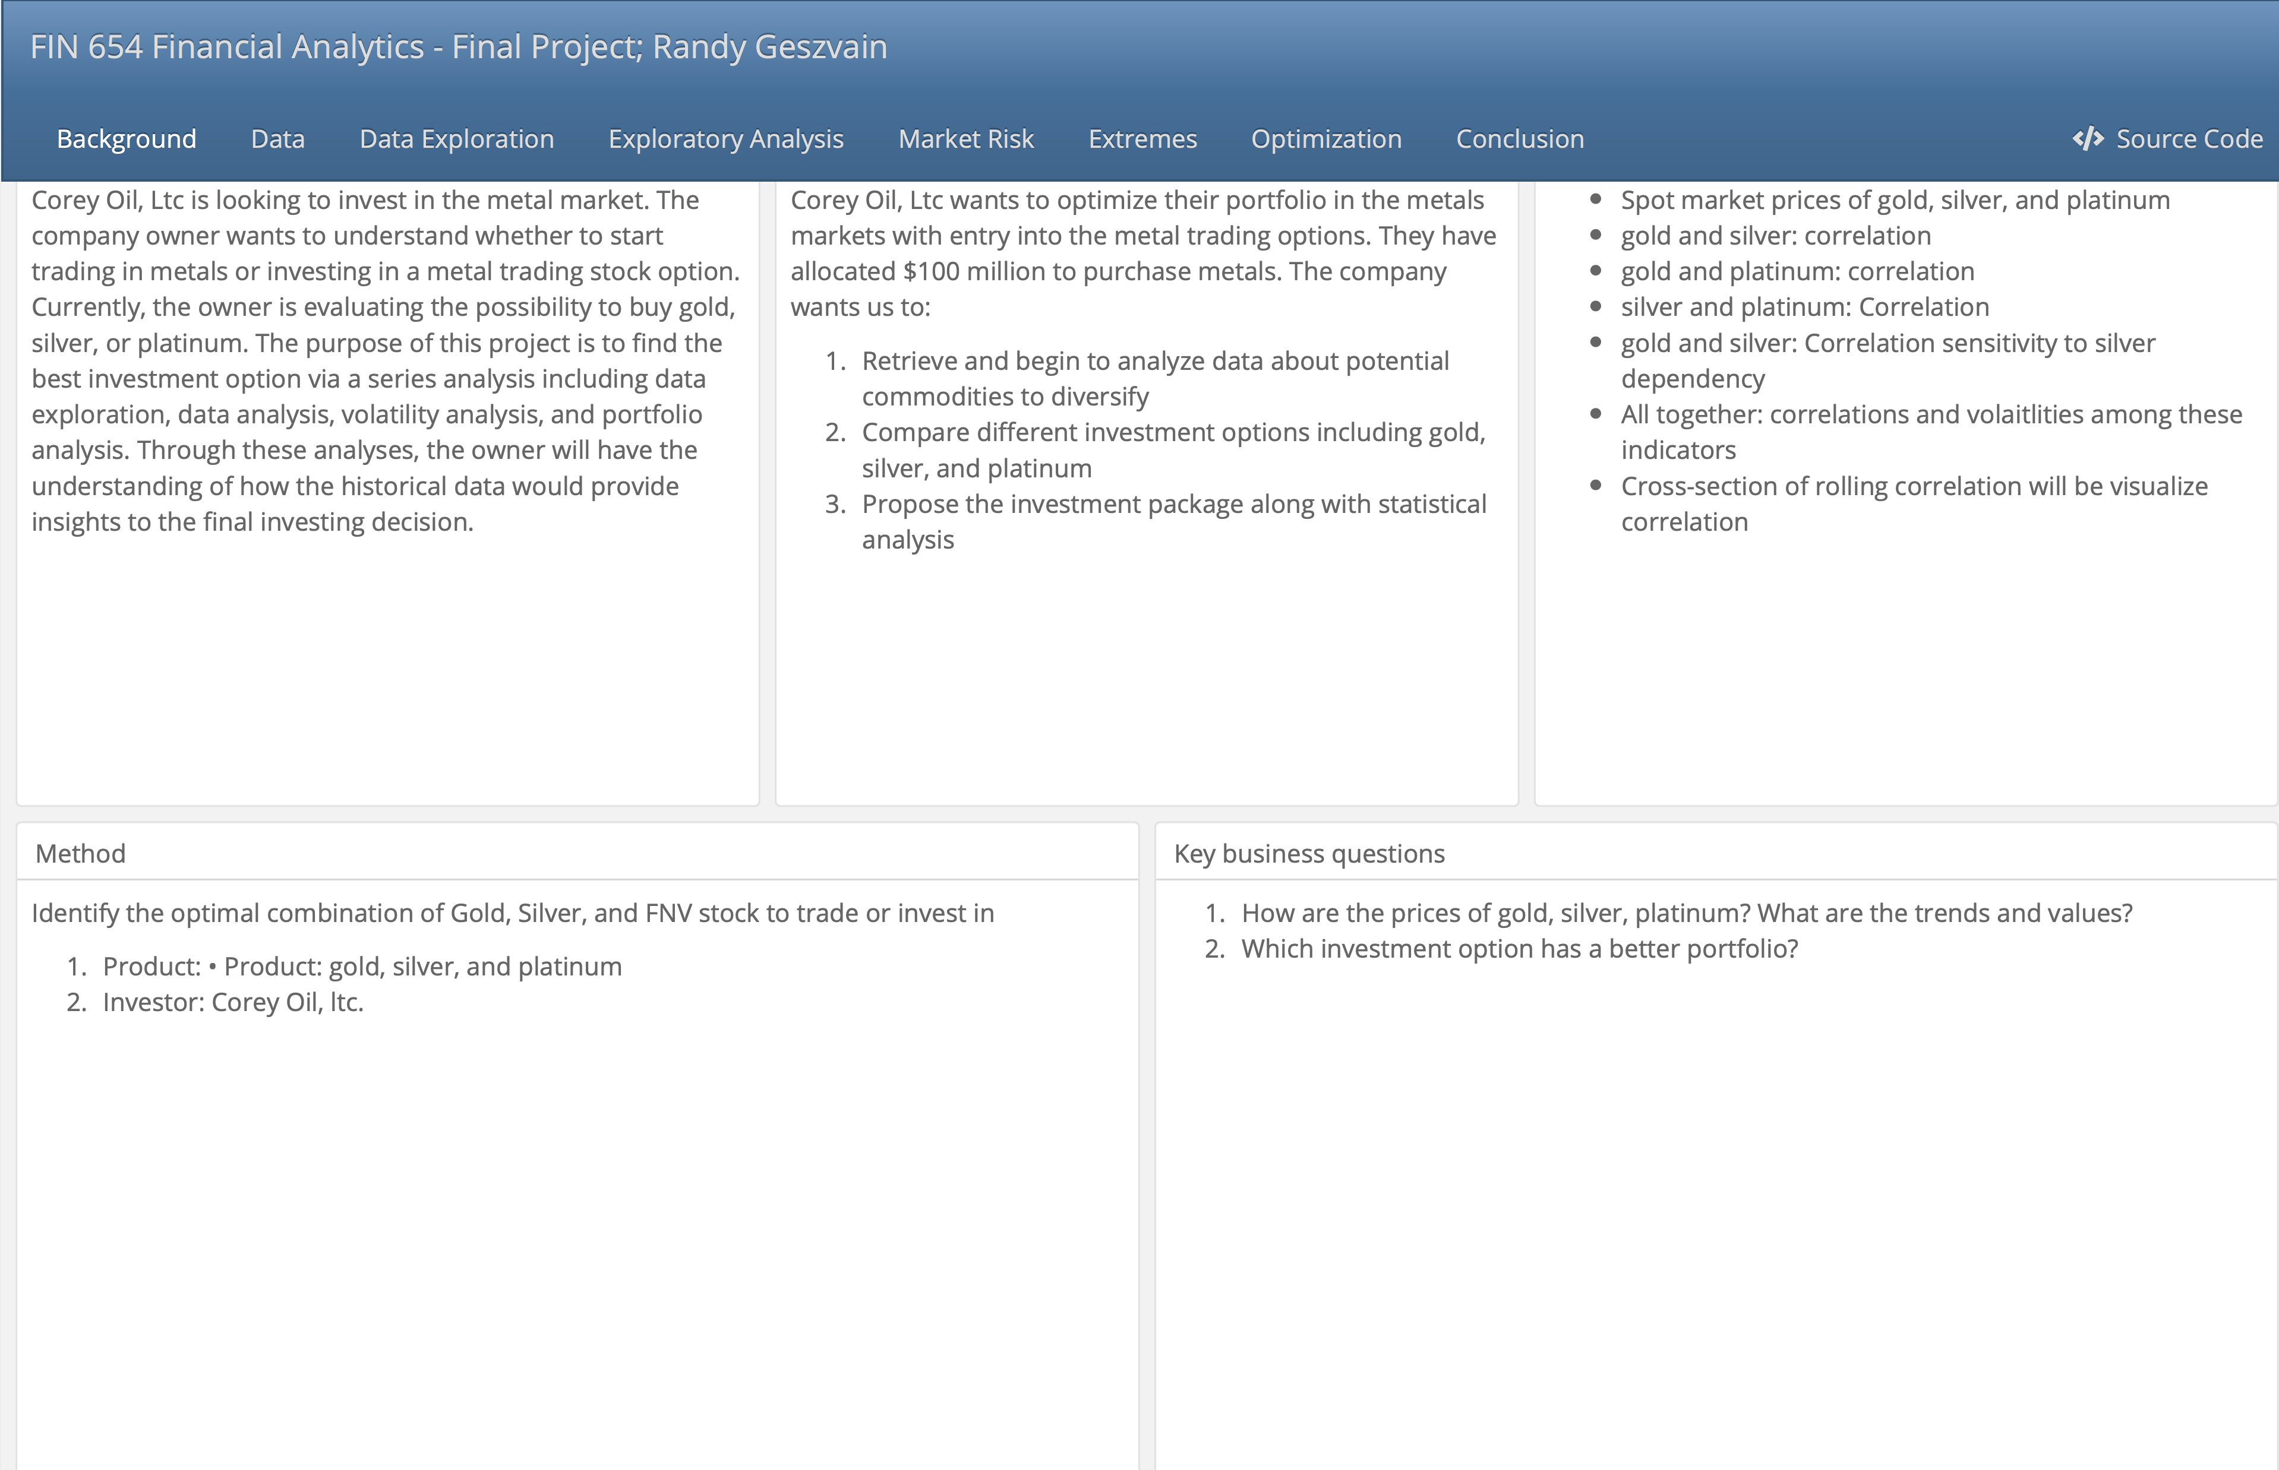

Slide 34
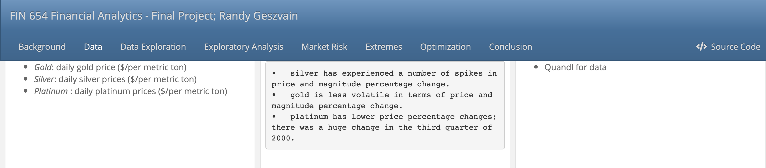
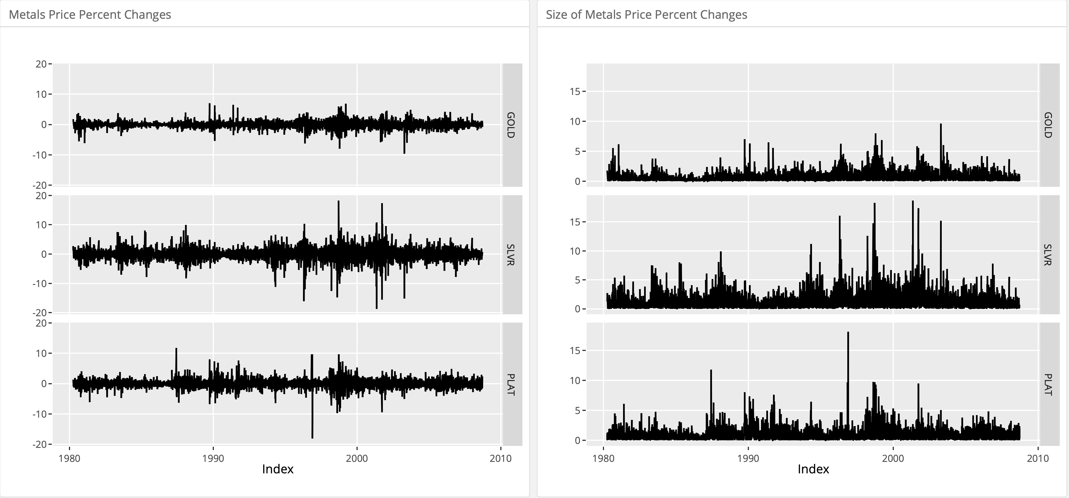

Slide 35
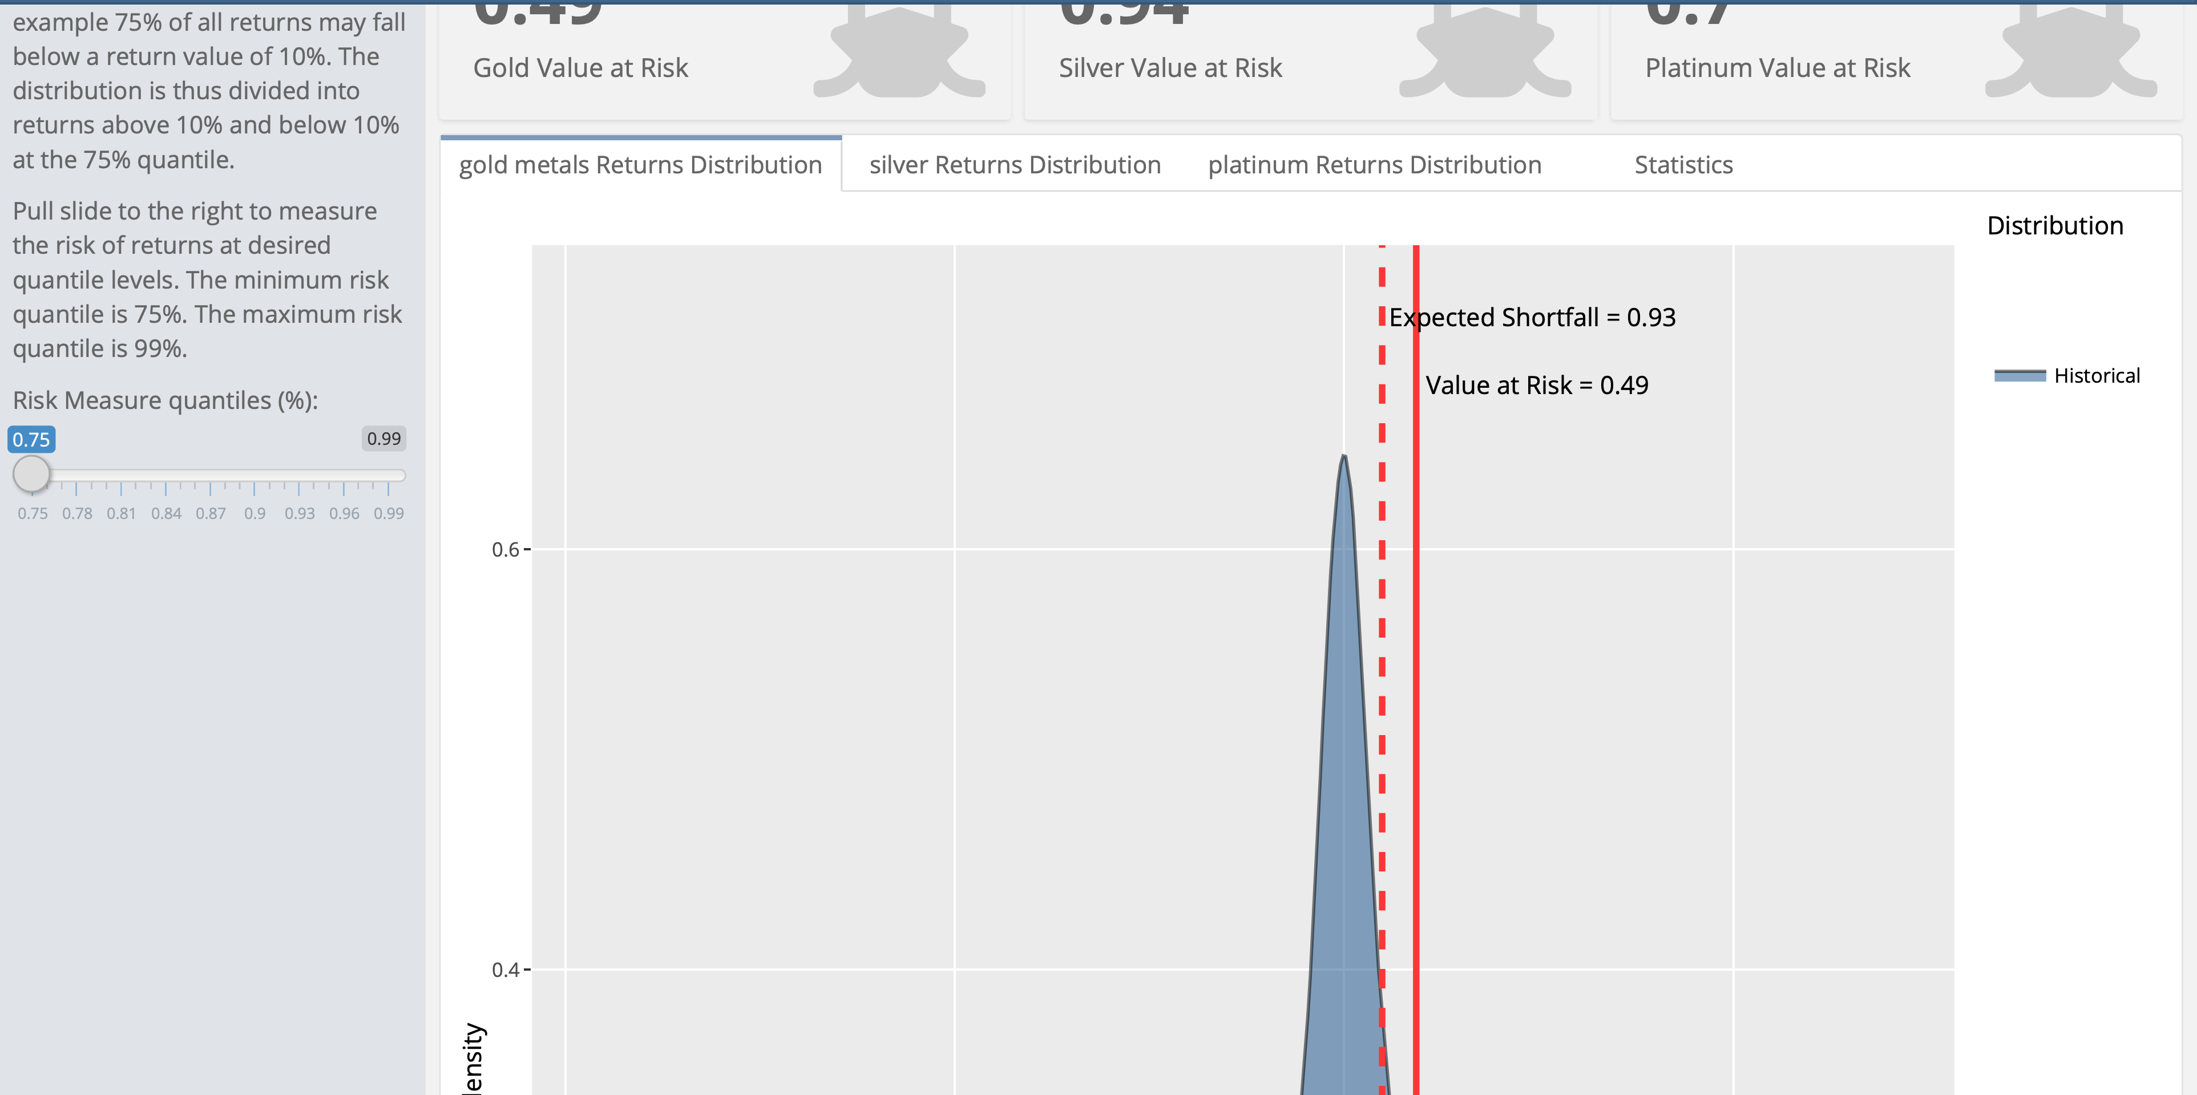

Slide 36
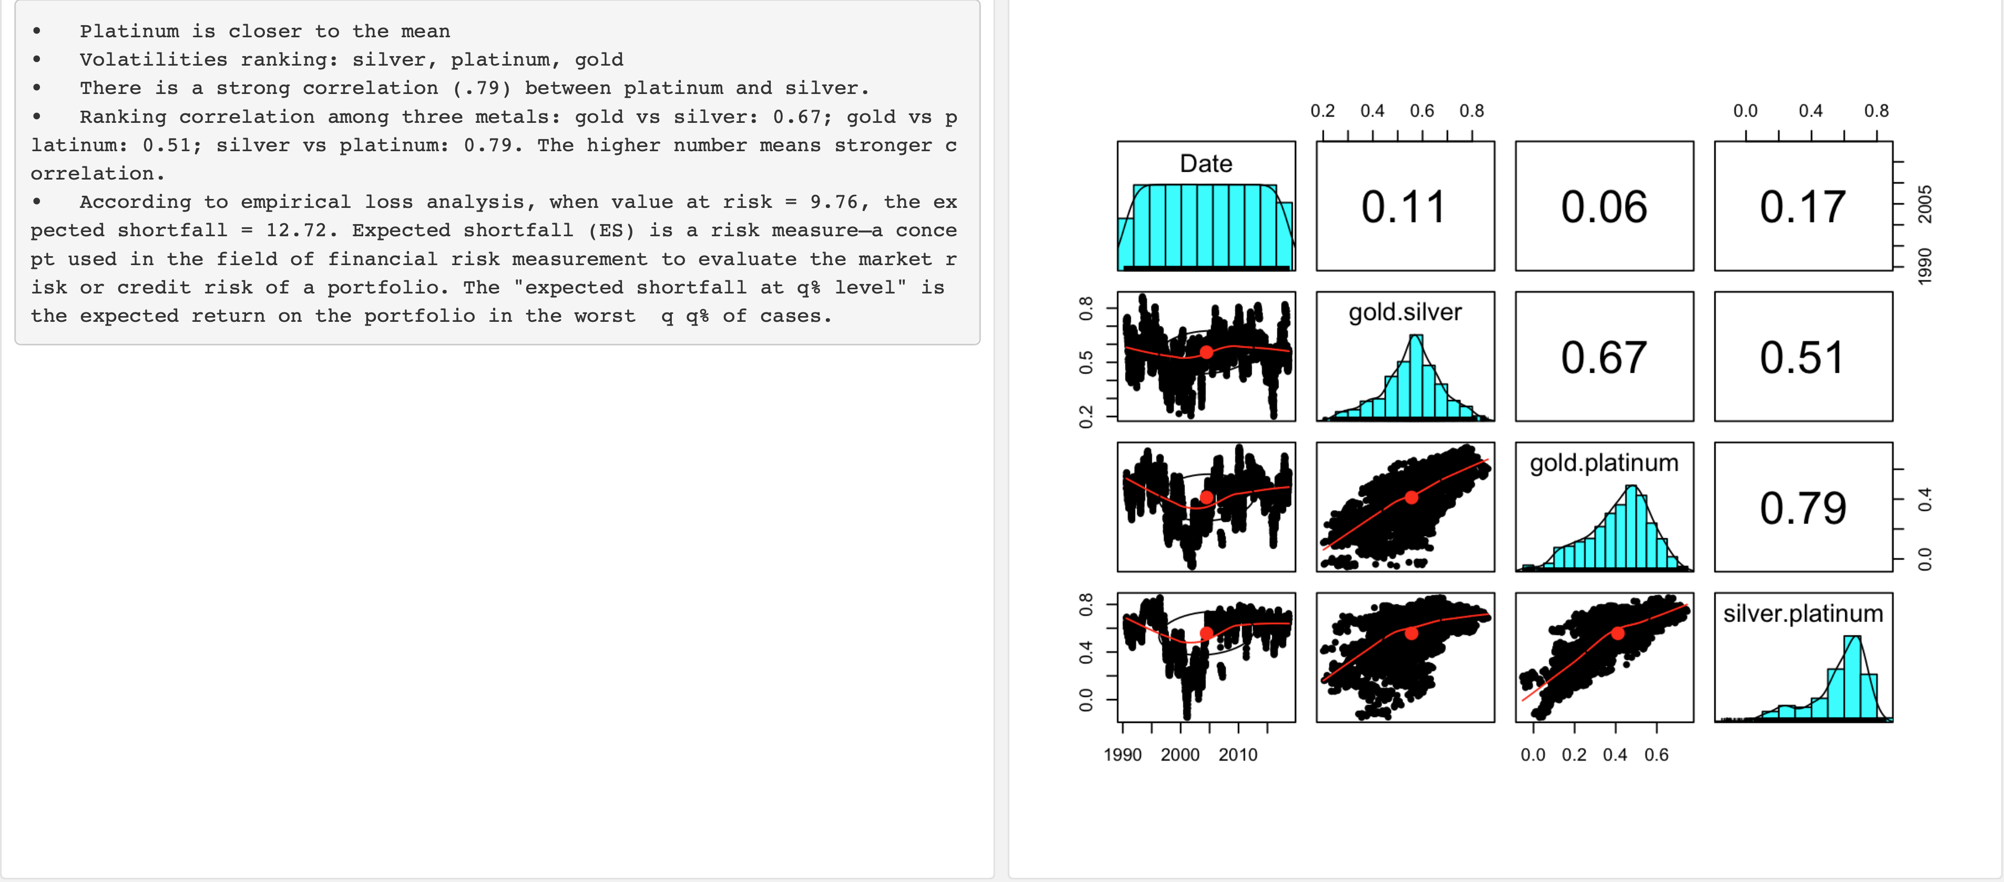

Slide 37
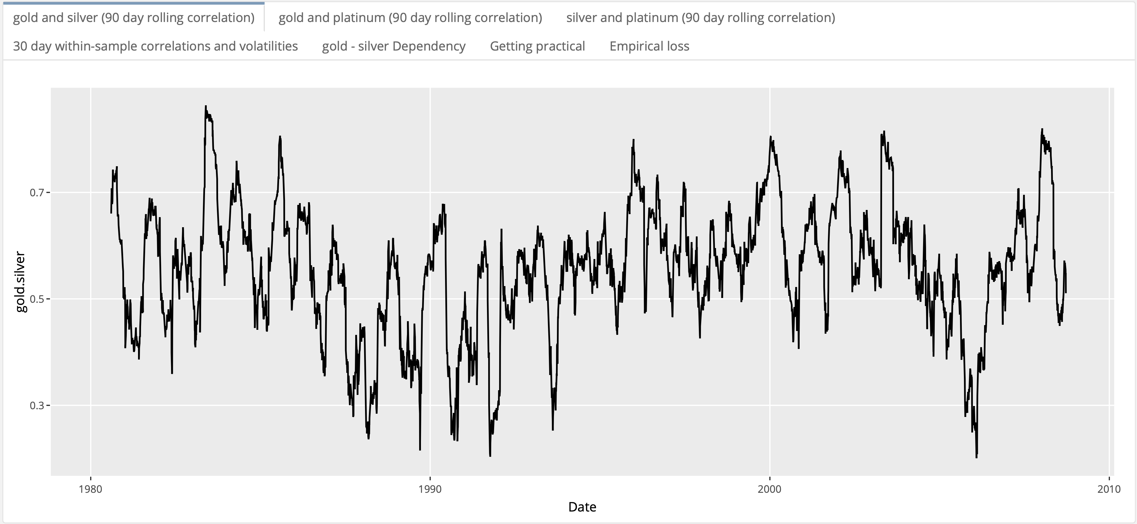

Slide 38
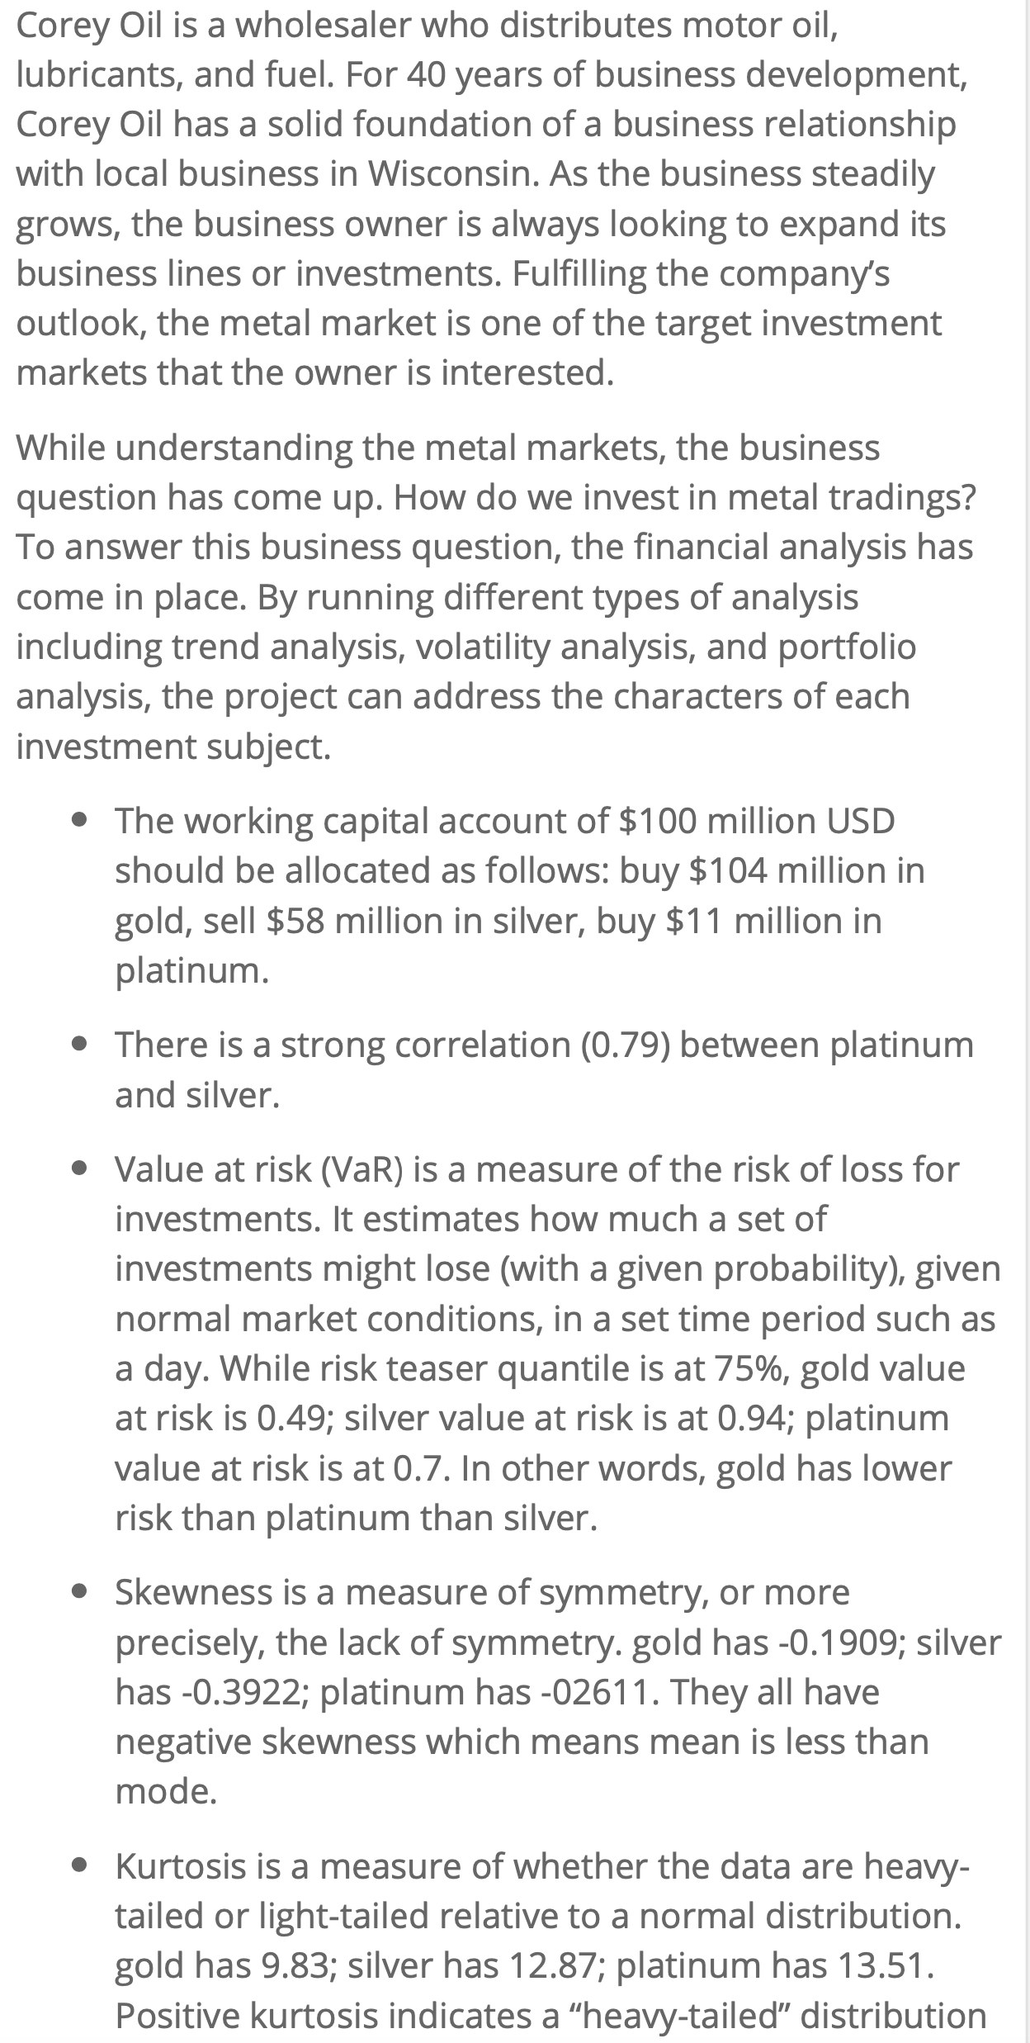

Slide 39
Project 4 -
Overview
Walkthrough

Slide 40
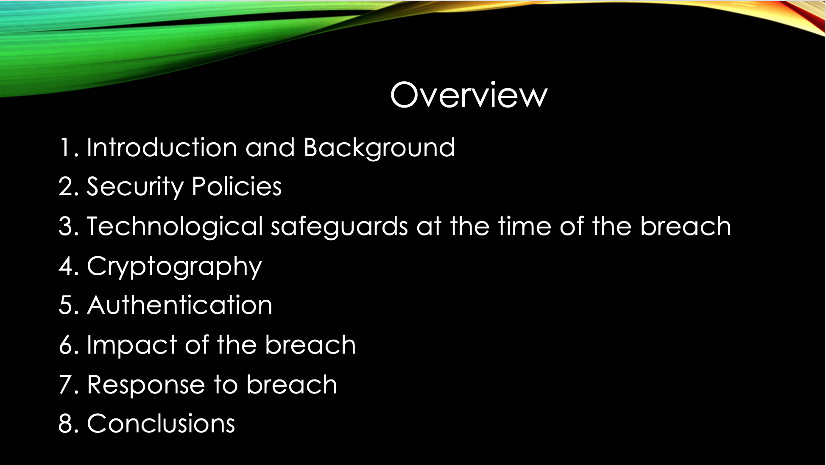

Slide 41


Slide 42
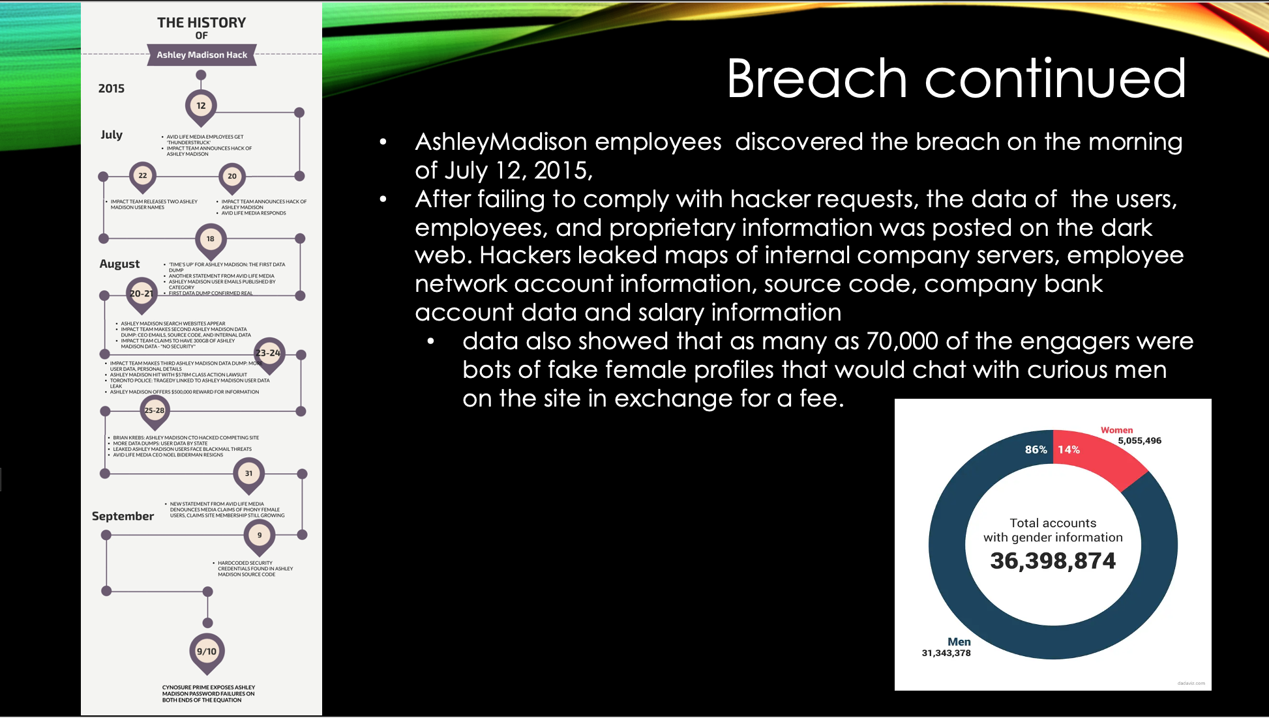

Slide 43
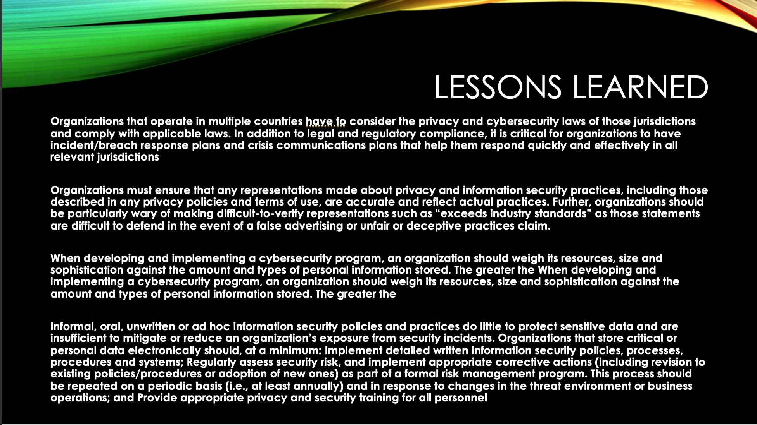

Slide 44
Data Science skills utilized

Slide 45
Collect and Organize Data
Applied Data Science – Corey Oil Sales data
Financial Analytics – stock data source
Big Data Analytics – unstructured data

Slide 46
Data Programing and Analytics
Statistical packages in R and python
Corey oil data set – EDA, neural network analysis, and machine learning models
Python Jupiter notebook – plotting and modeling
Data analytics – clustering and regression models.

Slide 47
Alternative Strategies
Big Data Analytics – random data collected
Plan x
Exploration stage to identify potential issues

Slide 48
Plan of implementations
Business values
Profit
Applied Data Science – sales trends and profit optimization
Big Data Analytics – data collections to predictions
Data cleaning, data exploratory, modeling, analysis, and conclusion.
DMAIC

Slide 49
communication skills
Visual impact - graphs and plots
Big Data Analytics – technical programming skills
Financial Analytics – graphs, plots, and interactive chart
Information Security – contexts and concept

Slide 50
ethical dimensions
Use data ethically
Profit versus data ethics

Slide 51
Conclusion
Finish line
Skills enhanced and continue to grow

